Slide 1
TUNA

Slide 2
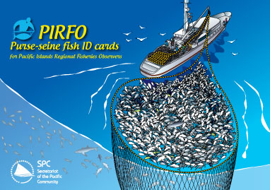
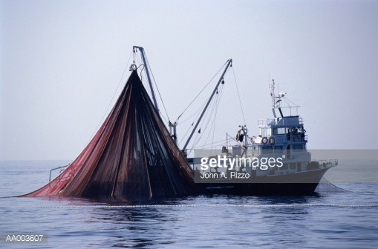
http://www.gettyimages.com/detail/photo/tuna-fishing-boat-raising-its-fishing-net-royalty-free-image/AA003607
http://www.spc.int/coastfish/index.php?option=com_content&Itemid=30&id=435

Slide 3
Extinction factors; Issues that interfere with conservation
Common good
Transnational issue
Enforcement
Demand, thus supply
Sovereignty
↑ Catch capabilities
Competitiveness= borrowing $
Subsidies
More fishers
‘Race to fish’ approach
Cheating
Corruption
FOCs
¤

Slide 4
Reasons for rights-based management (RMB) system; Resistance
Conservation= mutually beneficial
How to allocate rights; RFMOs
How to govern the RBM system
GS- behind, but want option to exploit
Domestic pressures
¤

Slide 5
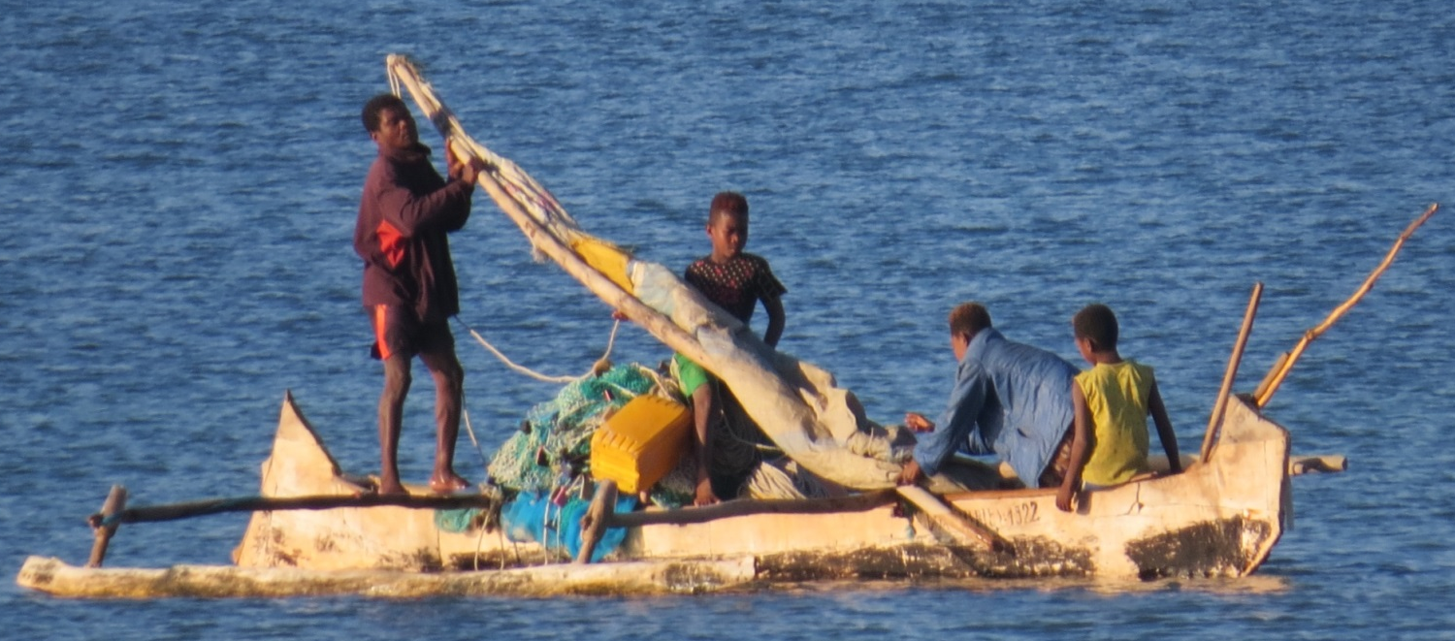
GN advantages over GS influence GS attitudes toward cooperation
MNCs based in GN
Subsidies
GS wants benefits
¤

Slide 6
Ways to protect
RBM
Fixed # of licenses
Fixed capacity
Public awareness
Aquaculture
¤

