Slide 1
The Basics

Slide 2
Global North-Global South Divide
Global North
Advanced Industrialized Countries
32 countries
Global South
162 countries (=83%)
Generic = ‘developing’
Emerging economies (EEs)= Majority >$10/day
¤

Slide 3
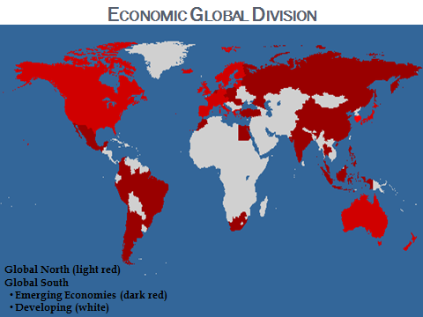

Slide 4
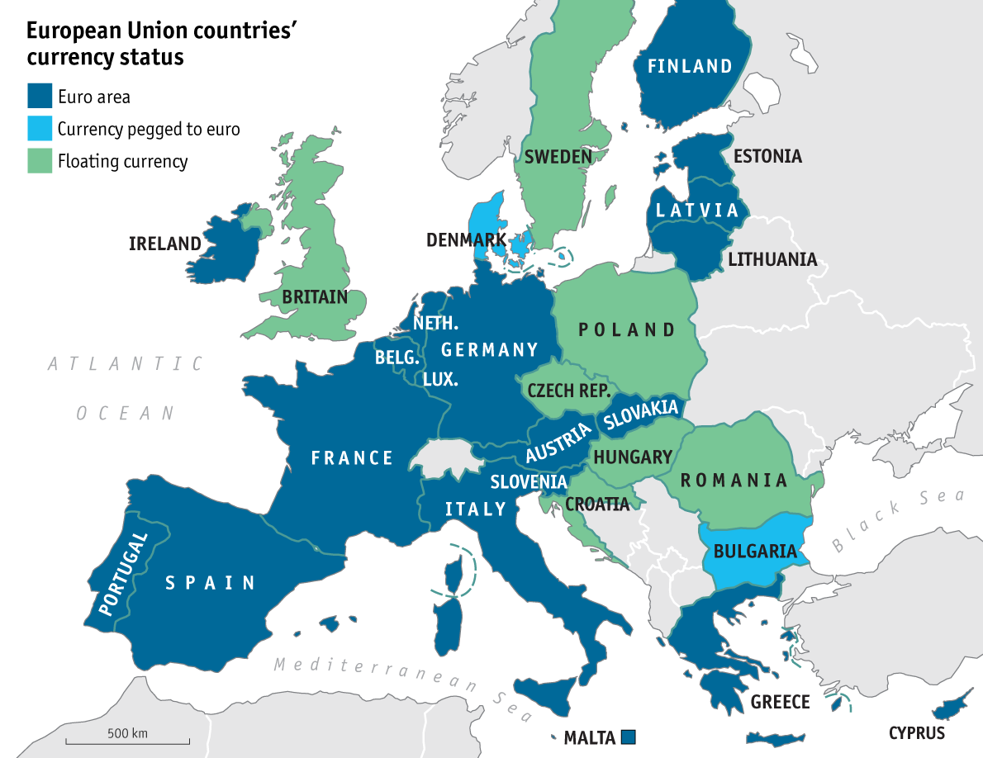
European Union (EU)
European Coal & Steel Community (ECSC)
Regional IGO (1951) of 6 states
Purpose: Promote regional trade
Present-day EU- 27
Trade union, but more
Significance to IMS→
Eurozone- 19 members
Significance to II&F→
Uniform investment rules
¤
http://www.economist.com/blogs/graphicdetail/2015/02/european-economy-guide

Slide 5
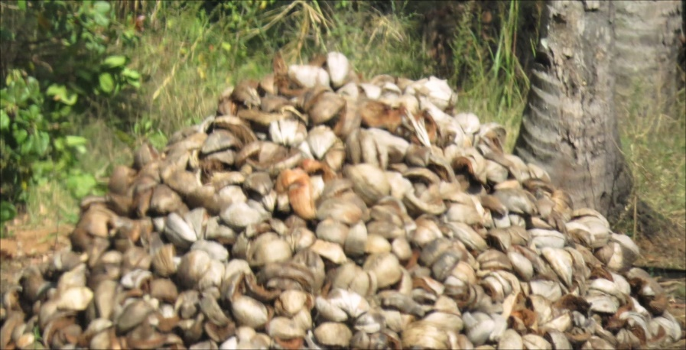
The Making of the Global South
Post WWII- colonies gained independence
Reliance on primary resources
Cash crops, raw materials
Desire to industrialize
Needed to borrow $= debt
¤
Crisis | Year
Mexico “Tequila Crisis” | 1994
“Asian Flu” Crisis | 1997
Russian “Ruble Crisis” | 1998
Argentina | 2001, 2014, 2023
Global Recession | 2008
Eurozone Crisis | 2010
Russia | 2023

Slide 6
Income Comparison
Burundi S 4%, I 2%, A 94%
France: S 79%, I 20%, A <2%
Malaysia: S 53%, I 36%, A 11%

Slide 7
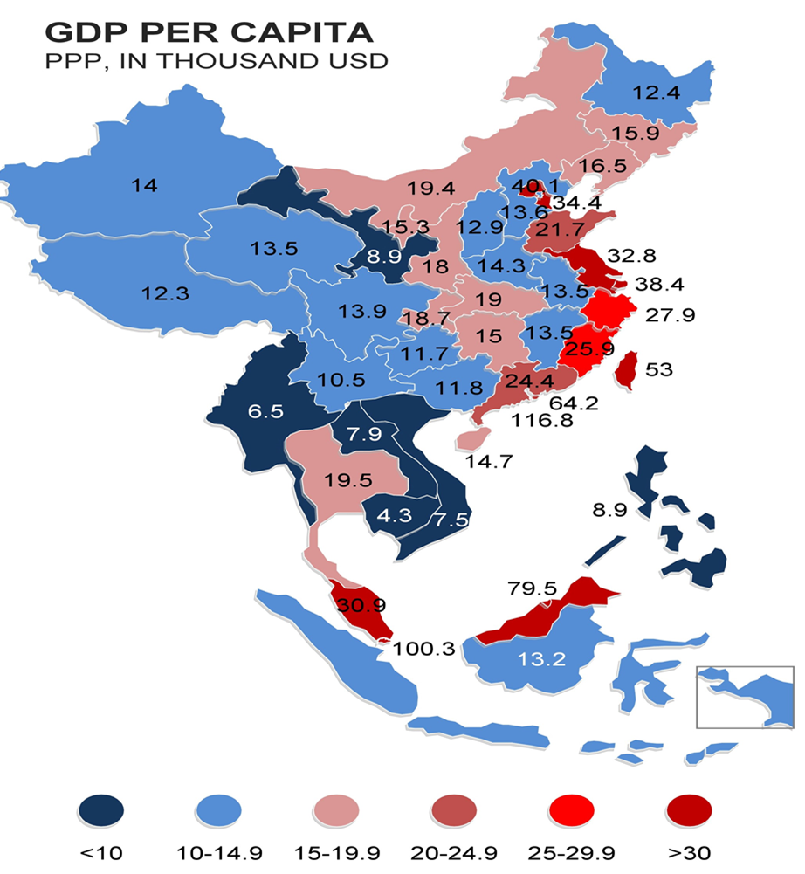
Income Inequality within China
https://www.aseanbriefing.com/news/wp-content/uploads/2019/12/GDP-Comparison-China-ASEAN.jpg

Slide 8
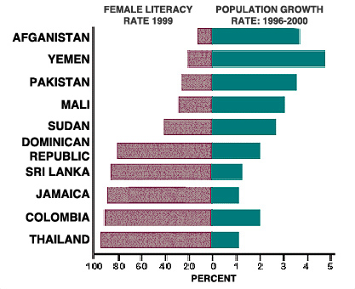
Income Inequality
More income equality → higher growth rates (IMF)
More gender equality → higher GDP p/c
Consequences of income inequality (IMF)
Fewer people w/ resource, credit access
Limited tax base = fewer social services
Corruption
Political instability → map
¤
http://www.glpinc.org/Web_pages/Illiteracy_Globally.html

Slide 9
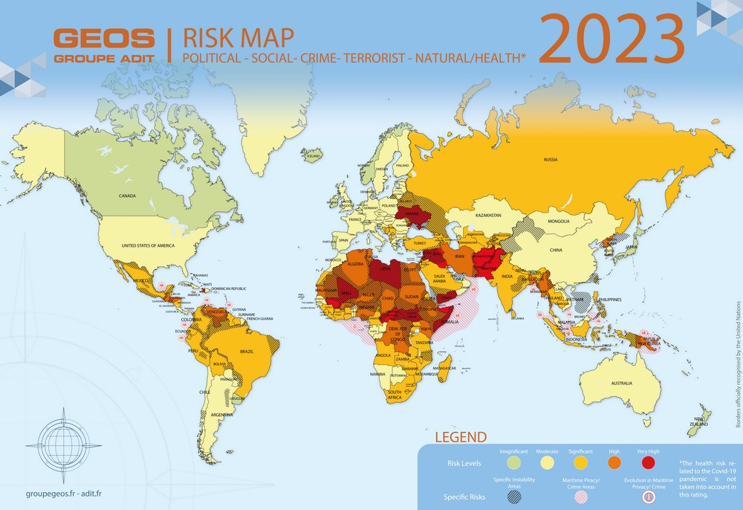
https://www.groupegeos.fr/riskmap

Slide 10
Int’l Political Economy
Three sectors: monetary, trade, investment and finance
GN/GS
How GS got into debt
How inequalities stifle development
Interconnectedness, interdependency of system
Efforts for global governance
¤

Slide 11
???
What would like to know about how the global economy works?

