Slide 1
IL &
IPE NORMS

Slide 2
Remittances
Globalized labor supply/demand
New Int’l Division of Labor
Part of export industry
Salaries, informal earnings, and non-migrant transfers
Rank by $ | Country | Remit total | % of GDP
1 | India | $87 B | 3.1%
2 | China | $60 B | .4%
3 | Mexico | $43 B | 4%
4 | Philippines | $35 B | 9.6%
5 | Egypt | $30 B | 8.2%
Rank by % | Country | Remit total | % of GDP
1 | Tonga | $194 M | 37.7%
2 | Somalia | $1.7 B | 35.3%
3 | Lebanon | $6.3 B | 32.9%
4 | S. Sudan | $1.2 B | 29.5%
5 | Kyrgyzstan | $2.2 B | 29.4%
https://www.worldbank.org/en/news/press-release/2021/11/17/remittance-flows-register-robust-7-3-percent-growth-in-2021

Slide 3
https://www.migrationdataportal.org/international-data?i=remit_paid&t=2020

Slide 4
https://www.migrationdataportal.org/international-data?i=remit_re_excel&t=2020

Slide 5
https://www.migrationdataportal.org/international-data?i=remit_re_gdp&t=2020

Slide 6
Benefits of Remittances
More effective than foreign aid
$ into local- esp. rural-economy
Fills in gov’t gaps
Bolsters gov’t gl. economic status
Liquid and hard $ v. FDI
More kids in school
Bypass corrupt officials
¤

Slide 7
Barriers to Remitting Money
Expensive
Huge fees
Peer-to-peer transfers
Mobile money= no fee
Use other channels
Local networks
¤
https://www.economist.com/leaders/2019/04/13/the-cost-of-cross-border-payments-needs-to-drop?frsc=dg%7Ce

Slide 8
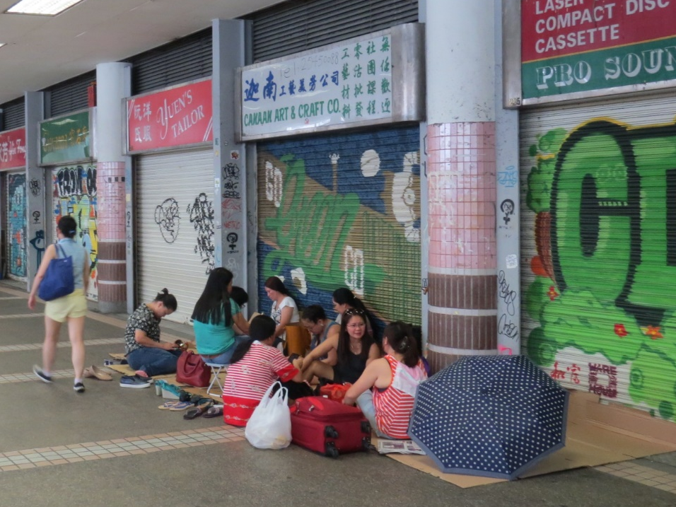
Barriers (cont.)
Regulations
Fear of illegal activities
Penalties on MNCs
MNCs bound by procedures
Define ‘risky’ transaction
Protect compliant MNCs
Role of GS
ID systems
India
Mobile money
Need competition
¤

Slide 9
Downside of Remittances
Fill low-paying, menial jobs
Live abroad
Backlash against migrant workers
Brain drain
Supports mostly consumption
Reliance undermines dev.
Enables gov’t inaction
$ transfer cost
¤

Slide 10
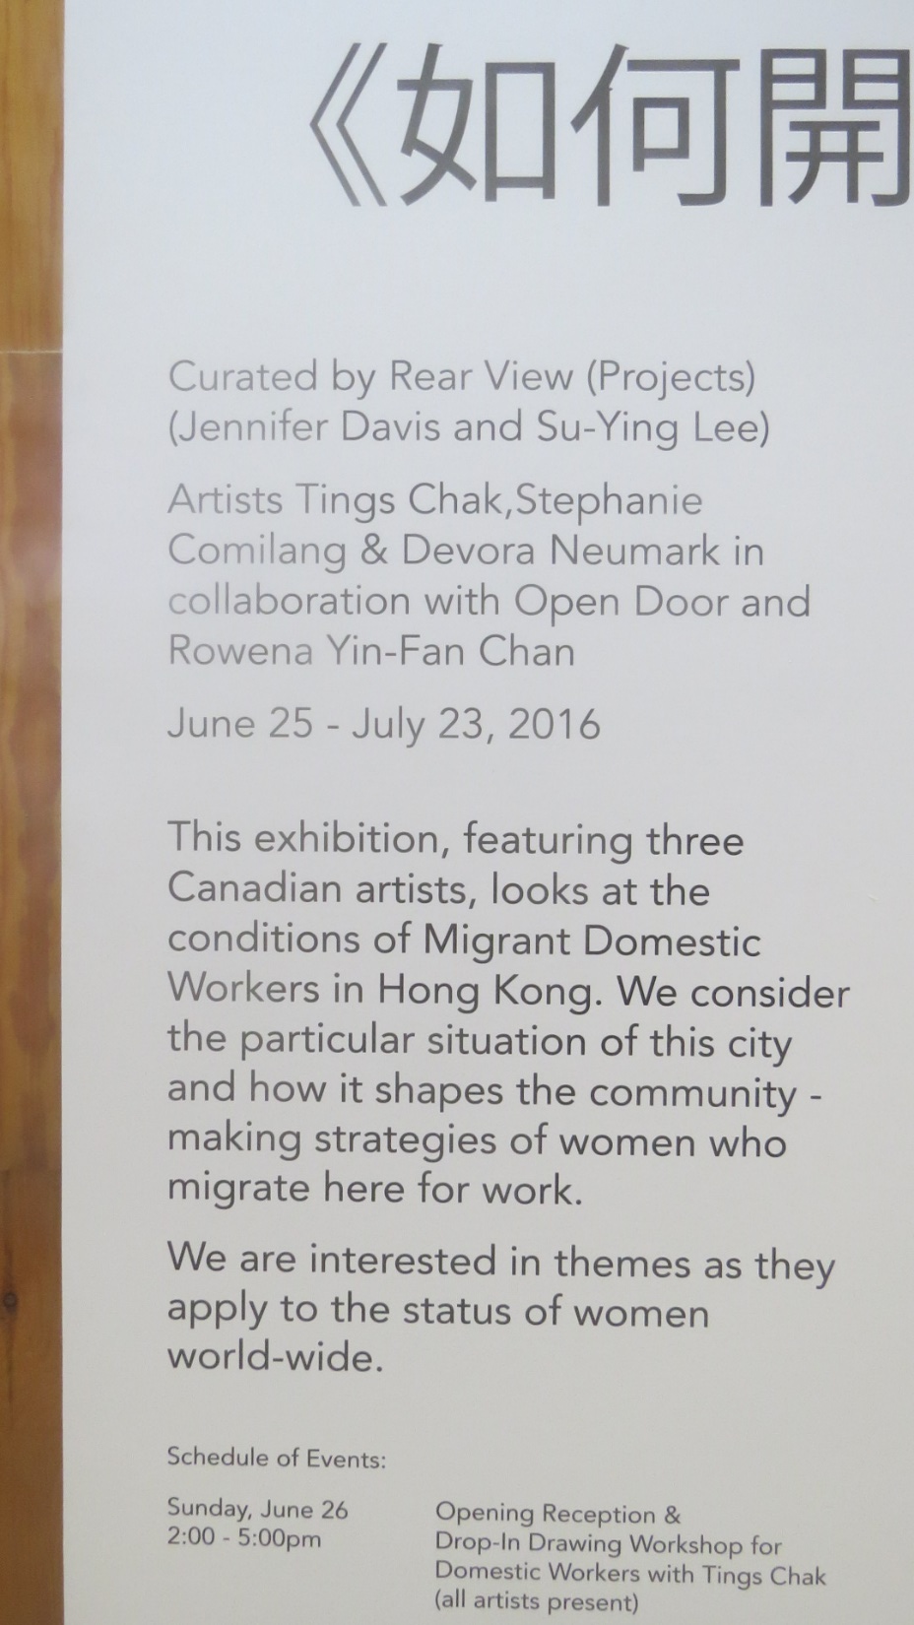
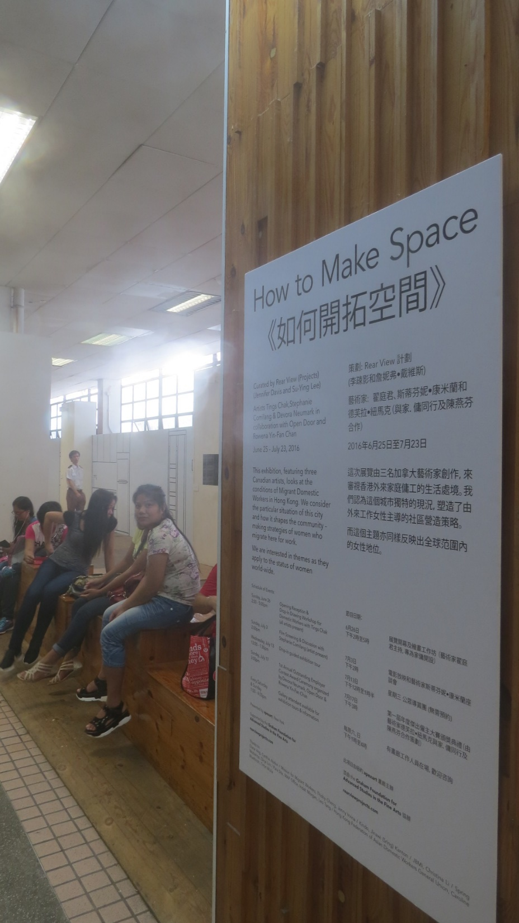

Slide 11
Downside of Remittances (cont.)
↓ gl. economy = blow
Less regional growth
Less $ goes into recipient economy
Fewer jobs in working country
Tighter immigration laws
↑ costs in working country= ↓ remittances
Work longer hours
Tap into savings
↑ poverty
↑ gov’t debt
¤

Slide 12
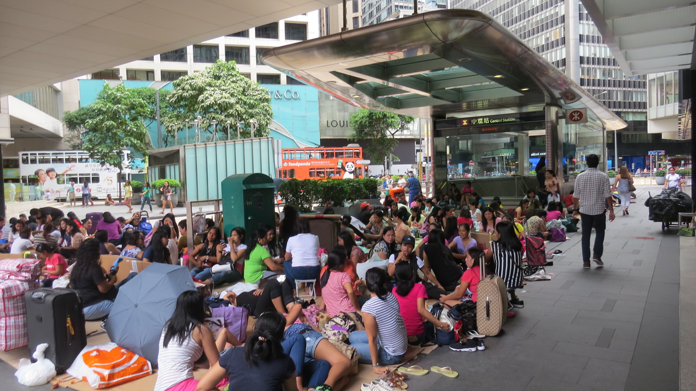

Slide 13
Recap
Global labor supply
Jobs abroad for remittance $
Illegal and/or forced labor supplies
Race to the bottom
Short-term v. long-term options
Challenges
¤

