Slide 1
Themes & Terms

Slide 2
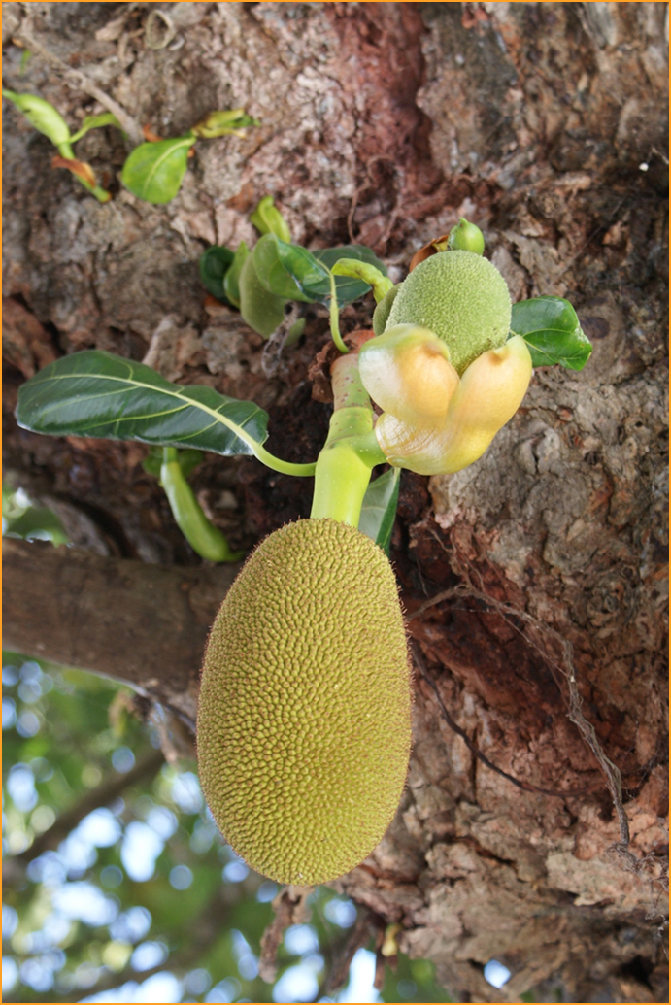
Colonization
What it is
Significance
Gives Europeans advantage
Sets foundation for GN, IMS, ITS, MNCs
Re: jackfruit
Staple food in tropics
No Eur. interest ≠ cash crop
Sets up interdependence
¤

Slide 3
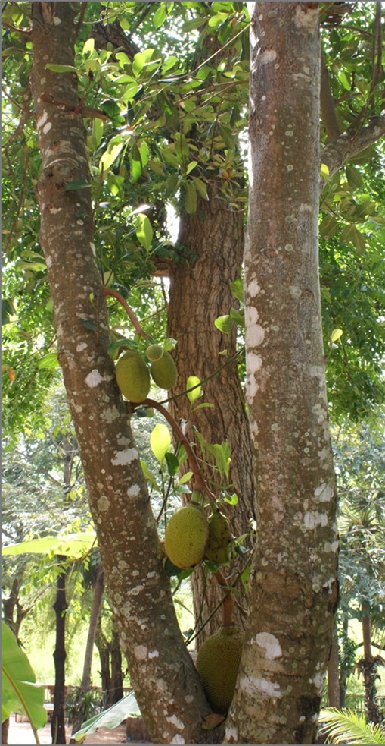
Neoliberal economic model (NEM)
What it is→
Free market capitalism
System hates gov’t interference
Gov’ts want security
Tariffs, non-tariff barriers (NTBs)
Promote domestic jobs
Limit foreign competition
Use institutions to coordinate policy
IMF, WTO, WB
¤

Slide 4
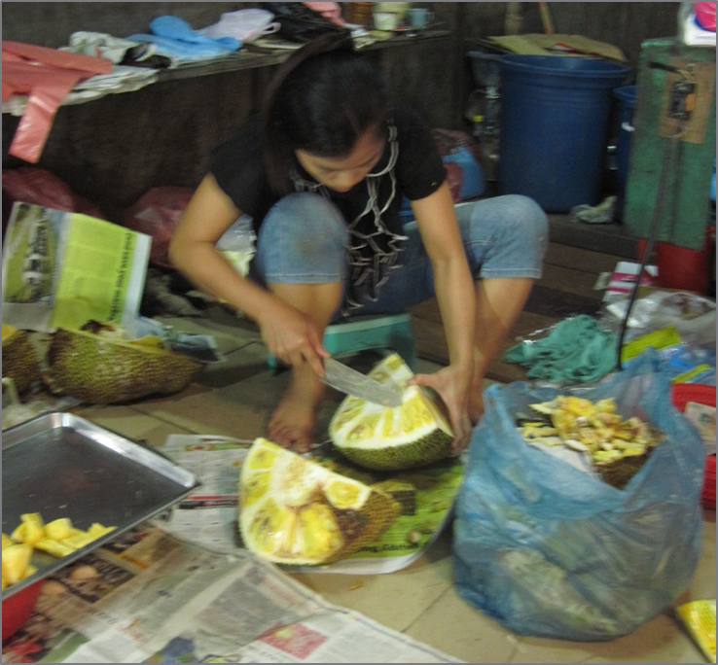
NeM (cont.)
Criticism→
Only bottom line matters
Labor unions
HR advocates
Small business owners
Environmentalists
¤

Slide 5
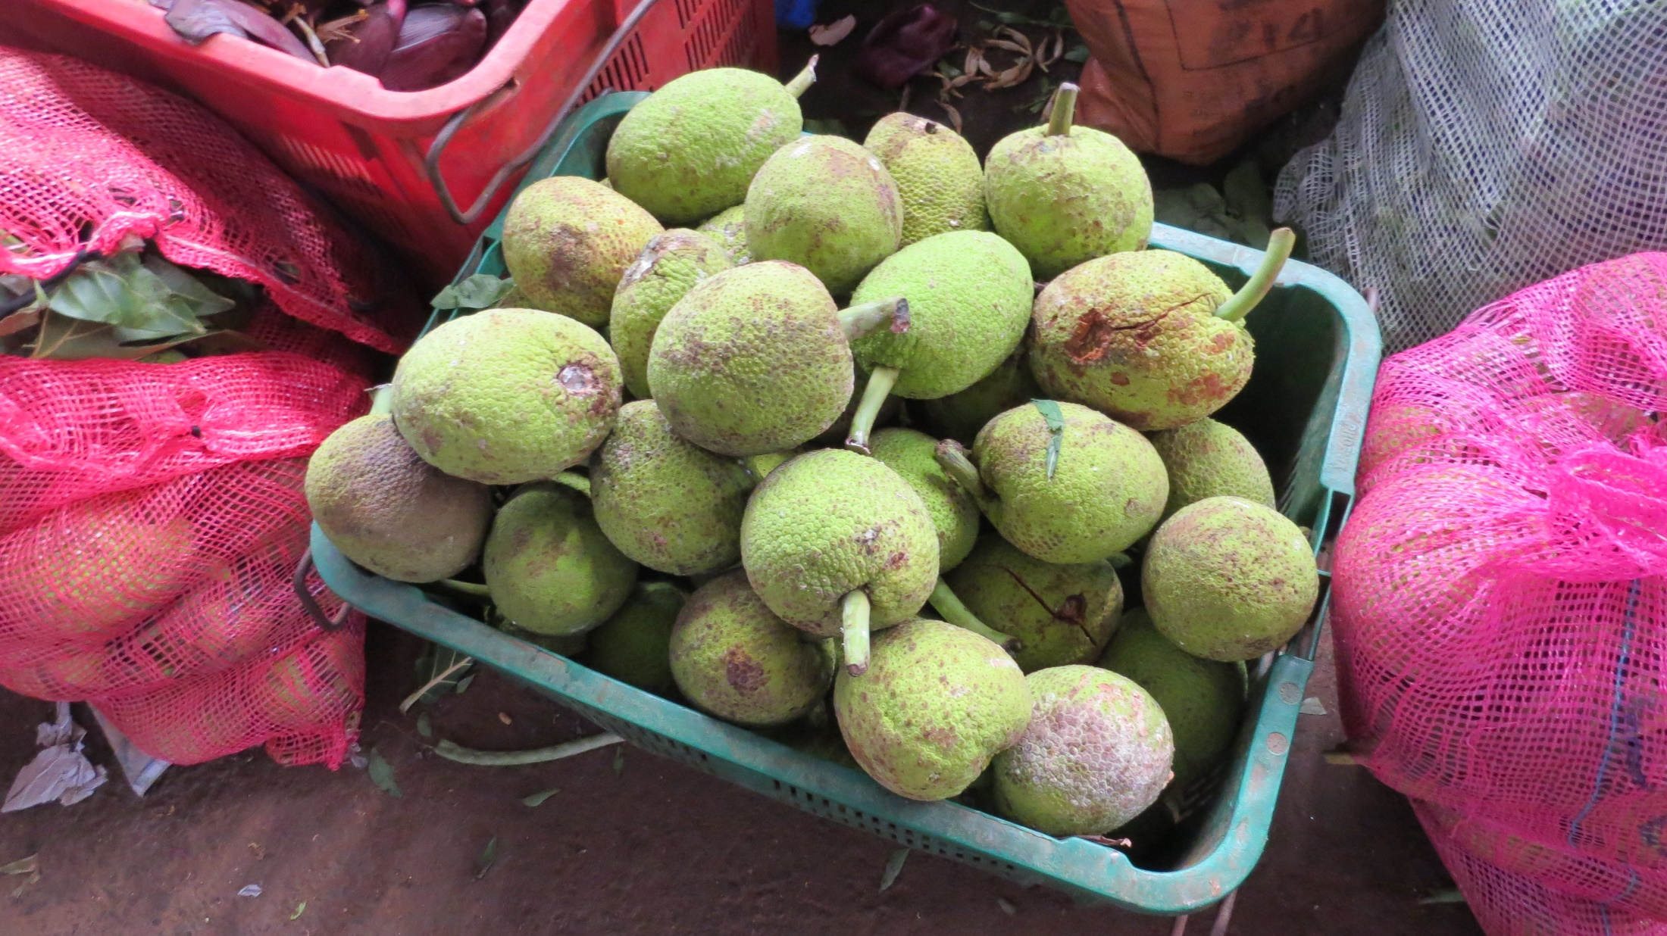
NeM (cont.)
Response to criticism→
Improves standard of living
Breaks down barriers
Limits competition
Makes products more expensive
Taps into global resources
↑ demand for foods, raw materials
Creates jobs
¤

Slide 6
NeM (cont.)
Re: jackfruit
GS: Short-term growth focus
Little buying power
Very little export demand
≠ cash crop
Increasing demand
Globalization factors
¤

Slide 7
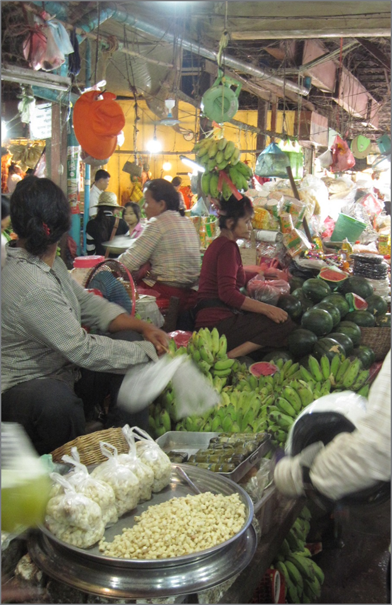
Global economic divide
Origins
Industrial Revolution
Colonization
Post-CW evident division
Significance
Wealth in GN
Lack of dev. in GS
Lack economic diversity
Diff. to pursue IL
Re: jackfruit
Meat substitute in GS
¤

Slide 8
Globalization
What it is
Concept under debate
Interconnectedness, interaction
MNC dominated
Set prices
Buy, sell
Create demand→ sell value-added products
Technology
¤

Slide 9
Globalization (cont.)
Re: jackfruit
Migration
Tourism→ demand elsewhere
Health conscious
Fusion cuisine
Invasive species in Brazil
Competes with native trees
Imbalance in food chain
Marmosets, coati—eat native bird eggs
¤

Slide 10
Recap
Chapter concepts: Transnational issues
Colonization → sets basis for GN-GS divide
Neoliberal Economic Model →perpetuates division
Globalization→ facilitates supply/demand
All are transnational issues
Challenge states
Require global cooperation to solve
Create IOs to tackle
Gov’ts→ IGOs; citizens→ NGOs
¤

