Slide 1
Food & You Recap

Slide 2
Gov’t PolicieS
Depression, WWII
Secure food
↑ grain production
Europe, Japan
Subsidies
Cash, insurance, tax breaks, etc.
Push FDI through MNCs
¤

Slide 3
ConsequenceS
Surplus
Undermined GS production
Excess corn → HFCS, bio-fuel
Shift to large-scale agribusiness
Treadmill effect
↑ processed & fast foods
Cheaper- $ and time
Convenient
Portion sizes
¤

Slide 4
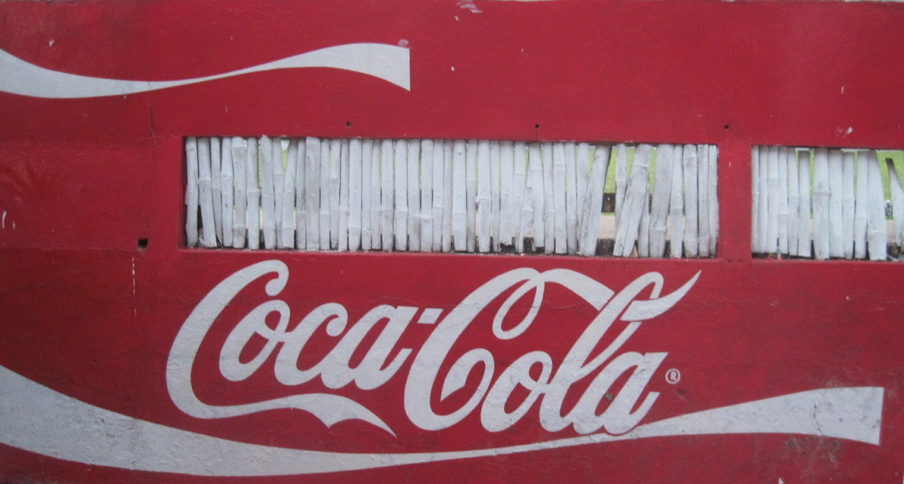
ConsequenceS (cont.)
↑ MNC control
Set conditions
Brand names
Killer products
Added-value
Gov’t reaction
Policies
¤

Slide 5
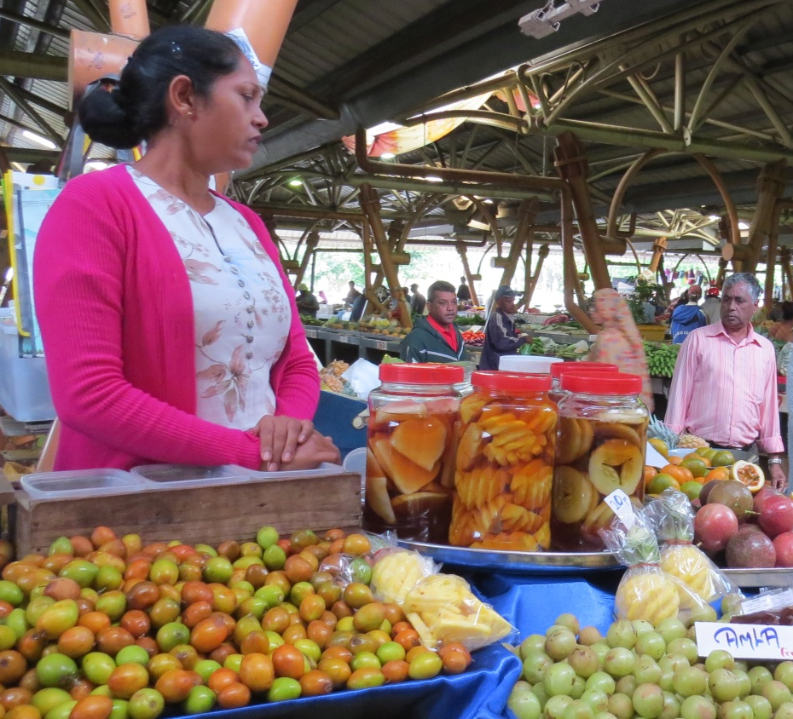
ConsequenceS
Health implications
↑ sugar, fat
Weight gain→ diet industry
↑ diseases
Health care costs
GS faces GN & GS diseases
↑ income
Fast food/ processed food access
MNC infusion to tap market
Cultural reasons
¤

Slide 6
RecaP
GN gov’t policies→
↑ grain production
↑ cheap processed & fast foods
↑ MNC influence
↑ health care issues, costs
Both GN, GS
Gov’ts respond w/ more policies
¤

