Slide 1
IR Theories

Slide 2
Realism
Variants: Neorealism, Structural Realism, Mercantilism (in IPE)

Slide 3
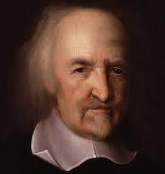
Thomas Hobbes 1588-1679
English Civil War
Fear
People are rational
Need gov’t
The Leviathan
“…and the life of man, solitary, poor, nasty, brutish, and short”
¤

Slide 4
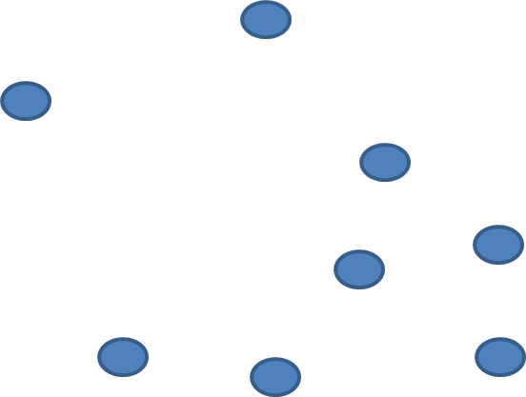
State of Nature
Social contract
→create government

Slide 5
HOBBES
In such condition as the state of nature there is
no place for industry
no culture of the earth
no navigation
nor use of the commodities that may be imported by sea
no commodious building
no knowledge of the face of the earth
no account of time, arts, letters, or society
¤

Slide 6
HOBBES
…instead, there is, which is worst of all
continual fear, and danger of violent death
and the life of man, solitary, poor, nasty, brutish, and short
¤

Slide 7
Hobbes argues: “Where there is no common power, there is no law; where no law, no injustice… [thus] they are in that condition which is called war.”
States act on self-interests
States battle for power
Who would stop them?
Either win or lose

Slide 8
State of Nature
Social contract
→create government

Slide 9
The International System

Slide 10
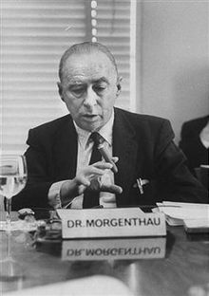
Hans Morganthau 1904-1980
World Wars
Politics Among Nations
Lays out realist tenets

Slide 11
Realism
Basic tenets
States=primary actors
National self-interest drives relations
Power struggles
No binding IL
Zero-sum relations
View of IR: Self-interested states competing for power

Slide 12
Liberalism
Variants: Neoliberalism, Idealism, Neoinstitutionalism

Slide 13
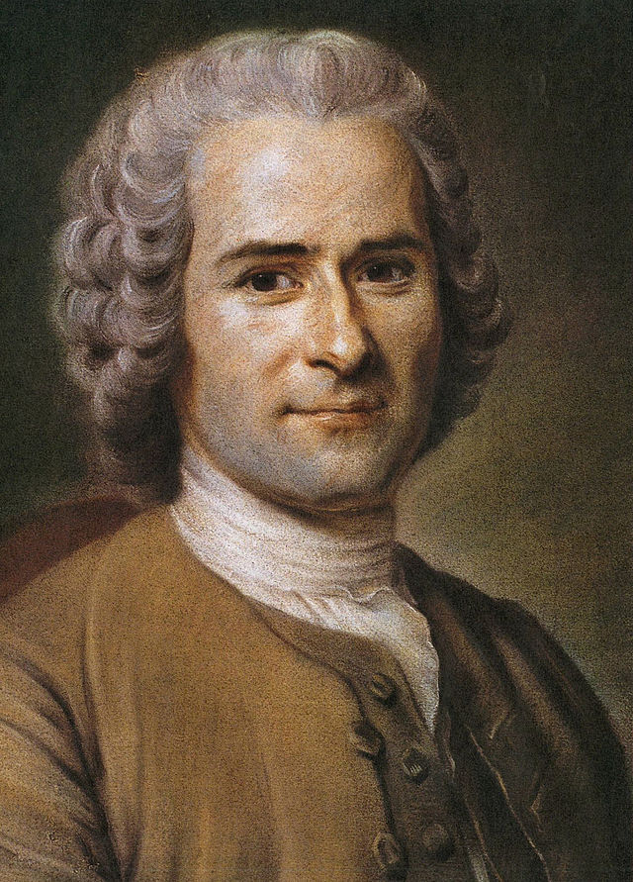
Jean Jacques Rousseau 1712-1778
Enlightenment
Social beings
Need gov’t
The Social Contract
¤

Slide 14
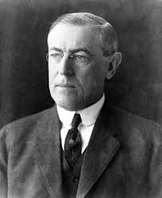
Woodrow Wilson 1856-1924
World War I
14 Point Plan
Ideas picked up in 1970s
¤

Slide 15
Liberalism
Basic tenets
Multiple actors matter
Relations based on more than just power struggles
Relations can be positive sum
Cooperation benefits the greatest number of people
View of IR: Various actors work towards cooperation for mutual benefit

Slide 16
Rousseau writes: “[t]he social order is a sacred right which is the basis of all other rights. Nevertheless, this right does not come from nature, and must therefore be founded on conventions.”
Need cooperation to progress
No cooperation leads to win/lose situations
Greater good for greater number

Slide 17
Recap
Realism: state-centric, dog-eat-dog world
Liberalism: cooperation between actors
Melian Dialogue
Athens: Might makes Right
Melians: Right makes Right
Interests
Power
Security
Strategic point
Economic growth
Control resources

