Slide 1
The State, Resources, & The Global Economy

Slide 2
What’s in a Name?
Denomination of origin = proprietary name
a.k.a. destination, appellation, geographical indication of origin
When is ‘manchego’ really ‘manchego’?
Spain wants to own the name
Mexico says it’s generic
When is ‘feta’ really ‘feta’?
Greece want to own the name
Denmark – ‘imitation’ feta allowed by EU
¤

Slide 3
Trade Issue
Dispute slowing EU-MX trade update
Inner-EU dispute
Viewed as trade barrier
Spain, Greece want sole use
Belgium 1996; Germany, Denmark 2005
Competition in other importing countries
Affects state’s income
Cheesemakers earn less
Spanish- less $ from Miami, US
Greeks- less $ in EU
Gov’ts get less from sales taxes
¤

Slide 4
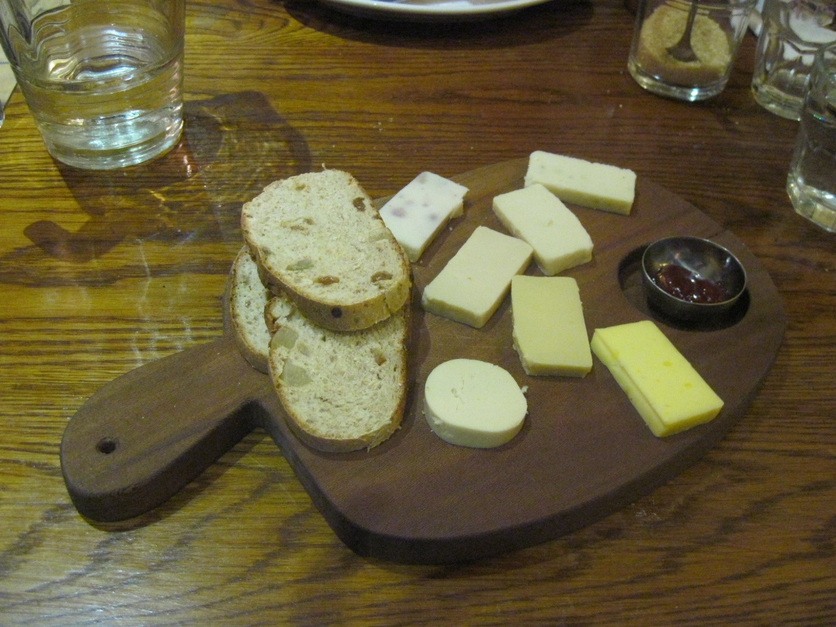
Trade & Cheese
Realists
State as key actor
Power struggle
Liberals
Multiple actors
Cooperation can be beneficial
¤

Slide 5
Trade
Why countries trade link
Types of trade
Primary, manufactured, services
Colonization
World Trade Organization (1995)
European Union (1992)
27 members after Brexit
Only 19 use euro (1999)
¤
https://europa.eu/european-union/about-eu/countries_en

Slide 6
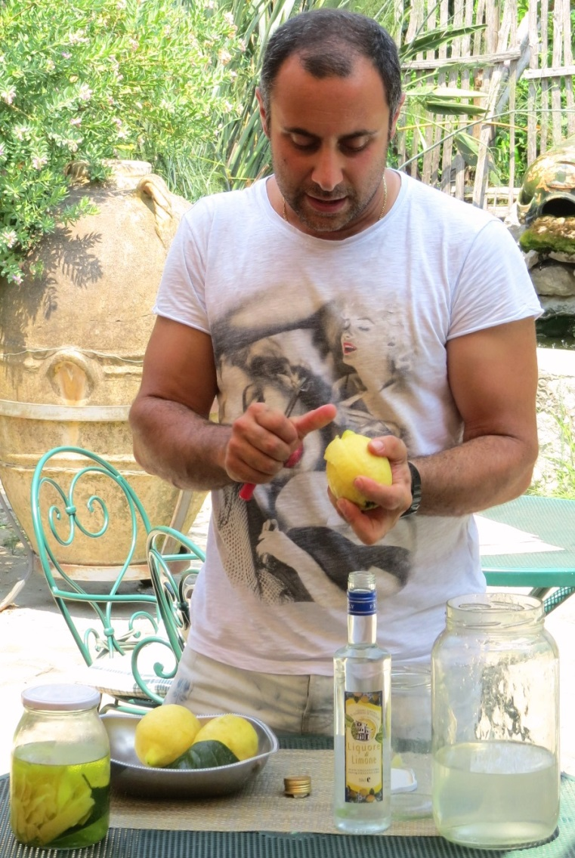
Trade Pacts
Minimize trade barriers
How they trade
Bilateral
EU-Japan, Canada- UK, US- EU
Multilateral
USMCA (was NAFTA), WTO, etc.
How trade deals affect you
Cheaper imports
More product choices
Better quality options
Standardized products
¤

Slide 7
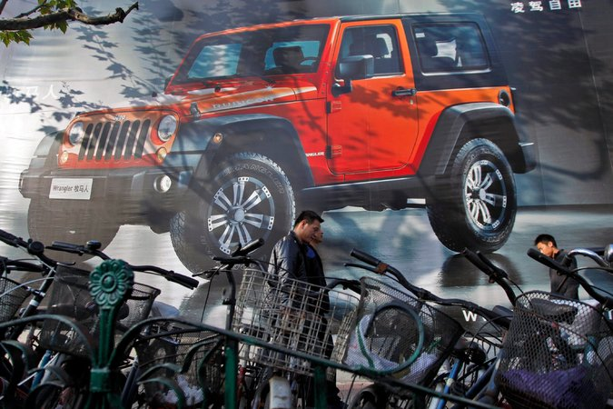
Trade Issues
Trade disputes
China taxes Australian wine link
World Trade Organization (WTO)
Dispute mechanism link
610 complaints; Ruled on 350+ cases
Recent rulings
US tariffs on Indian steel
Chinese tariffs on US cars
¤
Jeep Billboard in Shanghai
http://www.nytimes.com/2014/05/24/business/wto-ruling-on-chinese-tariffs-on-us-cars.html?_r=0

Slide 8
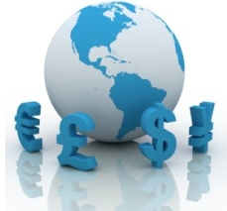
Economic Indicators
Gross Domestic Product (GDP)
Measures country’s wealth
GDP per capita
Measures average income per person
Country | GDP (IMF 2021) | GDP p/c in PPP(IMF 2021)
United States | $22.6 T (1) | $68,309 (15)
China | $16.6 T (2) | $12,624 (79)
Japan | $5.3 T (3) | $44,585 (43)
Germany | $4.3 T (4) | $56,956 (26)
India | $3 T (7) | $7,333 (155)
Nigeria (1st non-EE GS) | $514 B (27) | $5,280 (172)
EU | $20.9 T | $35,623 (59)

Slide 9
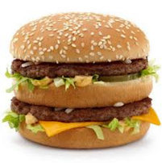
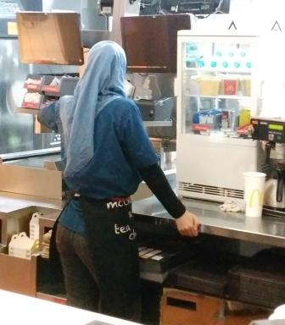
Economic Indicators (cont.)
How money works link
Purchasing Power Parity (PPP) link
Big Mac Index
What/how much people can buy
GN stronger currencies
 | Big Mac (ave. cost) | Could Buy | Abroad
U.S. | $4.93 | 11,028 Big Macs | 28,616 Big Macs in India
India | $1.90 | 895 Big Macs | 345 Big Macs in U.S.
Calculations based on IMF data 2015 and 2016 Big Mac Index

Slide 10
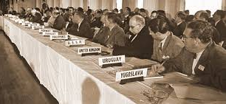
IGOs & MNCs
Economic IGOs
World Trade Organization (1995)
Bretton Woods Agreement (1944)
Int’l Monetary Fund (IMF)
Stability
World Bank (WB)
Development
Multinational Corporations
Foreign Direct Investment (FDI)
Control assets→ $$$
Gross Corporate Product (GCP)
Top 10 MNCs? link
Worldwide link
Walmart → 27th
¤
http://www.wsj.com/articles/SB122489333798168777

Slide 11
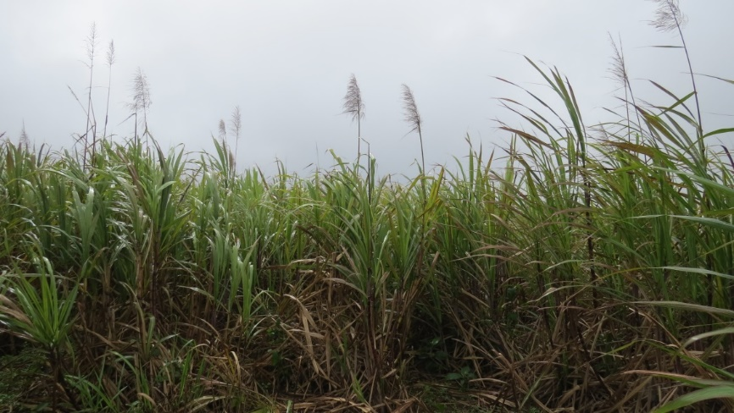
The State Recap
Sovereign, self-interested actors
Form IGOs like UN, EU, WTO, IMF
Try to control territory
Challenged by diverse population
Most states not nation-states
GN has economic advantage
Colonization to tap GS resources
Super interdependent
Need to cooperate on transnational issues
¤

