Slide 1
The State & Resources

Slide 2
Transnational Issues

Slide 3
What are Mangroves?

Slide 4
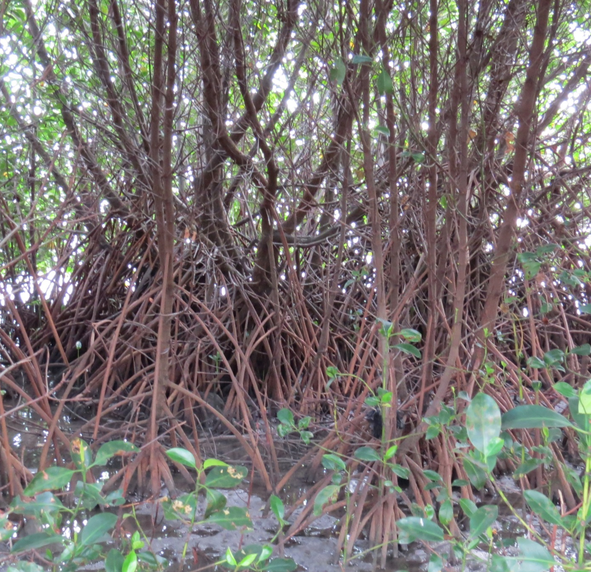
The Importance of Mangroves
Biodiversity
Water quality
Storm barriers
Capture, reduce, carbon emissions
Blue carbon
Coastal-captured carbon
Takes in 2-4 X more carbon
Livelihoods
¤

Slide 5
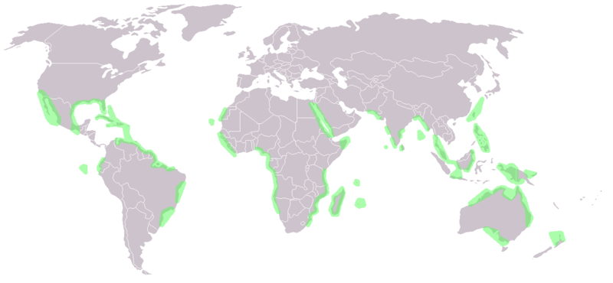
Where are the Mangroves?
https://upload.wikimedia.org/wikipedia/commons/9/95/World_map_mangrove_distribution.png

Slide 6
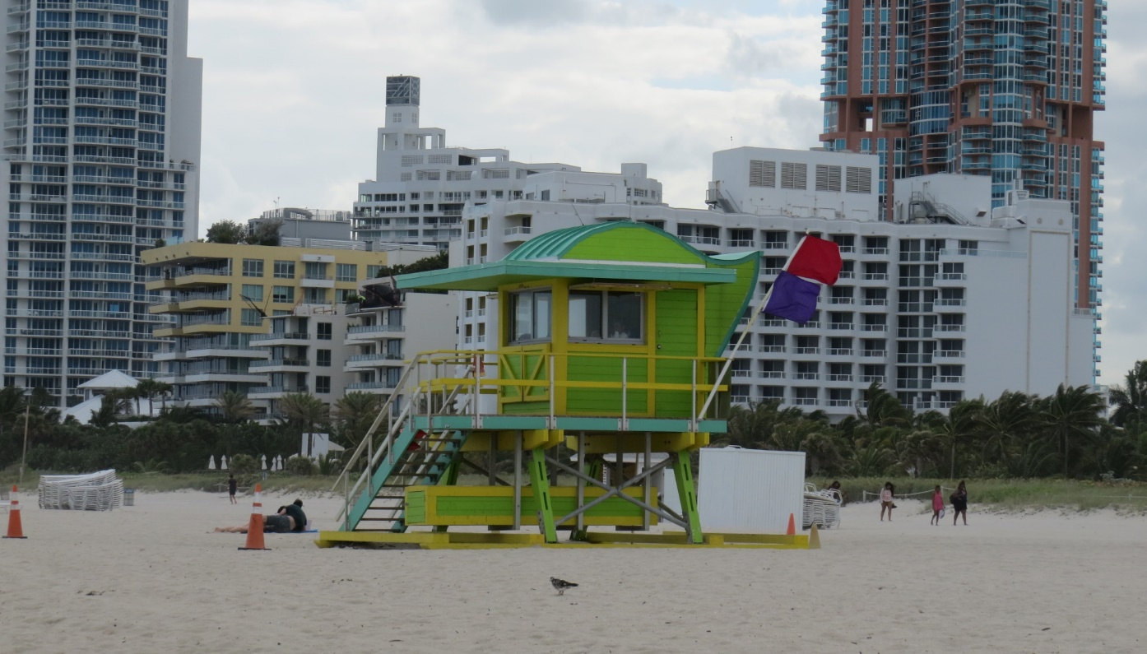
Destruction
Deforestation
Tourism
Beaches
Marinas
Exports
Aquaculture
Palm oil
Resources
Boats
Firewood
Pollution
Industrial waste
Soil erosion from deforestation
¤

Slide 7
Transnational issue
Environmental
No longer process emissions
Release stored CO2 → climate change
Soil erosion → pollution
Economic
Need financial incentives to protect
Funding, support to locals
Profits from resources, tourism
Carbon permits
Free market trade
Pay to pollute
¤

Slide 8
Transnational Issue (cont.)
Political
States
IGOs
UN (UNEP, FAO), World Bank, IMF
NGOs
Blue Carbon Group, Mangrove Action Project
Health
↑ global temps.=↑ spread of disease, ↓ nutrition
Human rights
Standard of living
¤

Slide 9
Recap
In sum, transnational security issue
Mangroves provide resources
Destruction has global implications
Conservation requires global cooperation
Depletion increased by globalization
Need financial incentives
¤

