Slide 1
The State

Slide 2
Population

Slide 3
Defining States: Population
Nation
Culturally and historically similar
Feel a communal bond
Want recognition
Possible self-governance
State = country
Most (85%) have 2+ nations or lack single identity
Others (15%) called ‘nation-states’
Specific to mostly homogenous state
¤
Demographic
Arab Amazigh
Russian Chechnyan Turkic Caucasian
Chinese Malay Indian
Canadian Indigenous Quebecois
Thai
Japanese
Somali
Demographic | Country
Arab Berber Moroccan | Morocco
Russian Chechnyan Turkic Caucasian | Russia
Chinese Malay Indian | Singapore *4 official languages
Canadian Indigenous Quebecois | Canada
Thai | Thailand
Japanese | Japan
Somali | Somalia
Wanna-Be States
Taiwanese | Catalans
Palestinians | Basques
Kurds | Scots

Slide 4
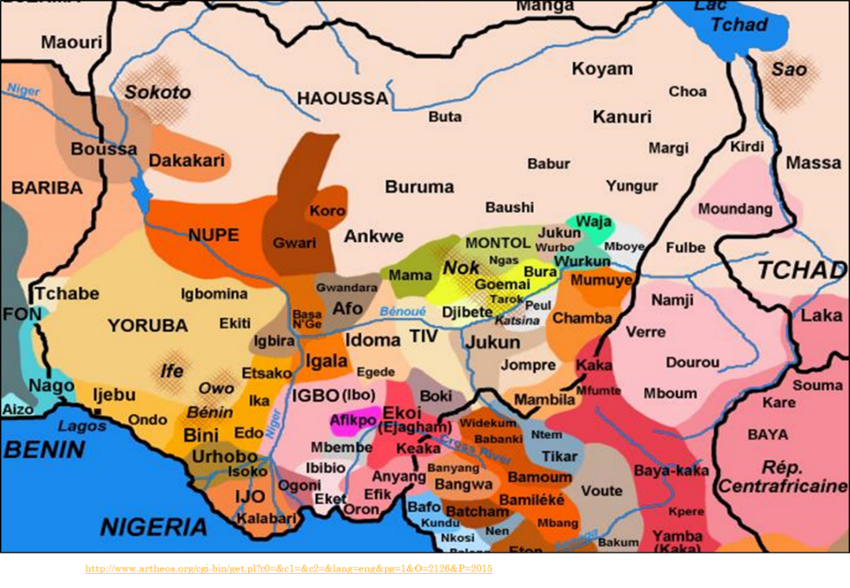
Decolonization
Nations cross political borders
Inadequate infrastructure

Slide 5
One State, Multiple Nations
Ethnic Groups
Pashtun 42%
Tajik 27%
Hazara 9%
Uzbek 9%
Ismaili 4%
Nuristani 4%
Turkmen 3%
Baluchi 2%

Slide 6
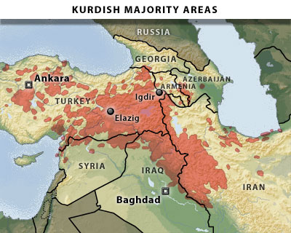
Nation w/o a State
Nations
Kurds
1 nation, 7 states
Chechnyas
Basques
Catalans
Others?

Slide 7
Population Problems
Lack unity
‘Minorities’
Indigenous, ethnic groups
Harder for GS to handle
Limited resources, infrastructure
Failed states
Only GS
¤
Central African Republic
Baya | 33%
Banda | 27%
Mandjia | 13%
Sara | 10%
Mboum | 7%
M’Baka, Yakoma | 4% each
Failed States
Somalia | Libya
Sudan | DR Congo
Central African Republic | South Sudan
Minorities
Rohingyas | Darfuris
Uighurs | Quebecois
Chiapas | Maori

Slide 8
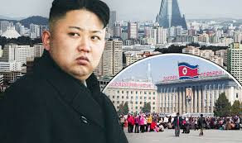
Territory & Population Recap
States need sovereign recognition for territorial claims
Border disputes common- even over outer space
Difference bt. state and nation
Most states are heterogeneous
Very few nation-states
State has final say
Self-interested actor
Re: transnational issues
Form IGOs
Pressure to follow rules
GN, EEs more leverage
Don’t address = problems
¤
http://www.express.co.uk/news/world/791251/kim-jong-un-north-korea-imminent-war-pyongyang-immediate-evacuation

