Slide 1
The State

Slide 2
Territory

Slide 3
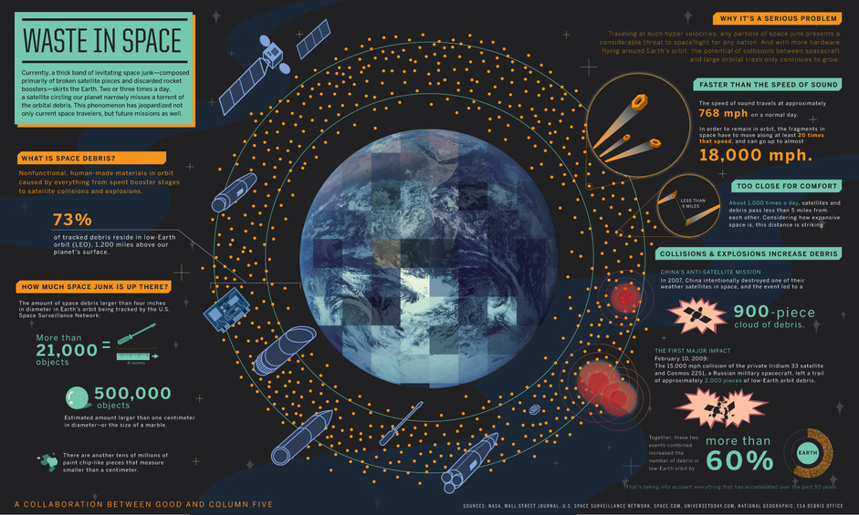
What is Space Junk?
http://www.jpl.nasa.gov/infographics/infographic.view.php?id=10929

Slide 4
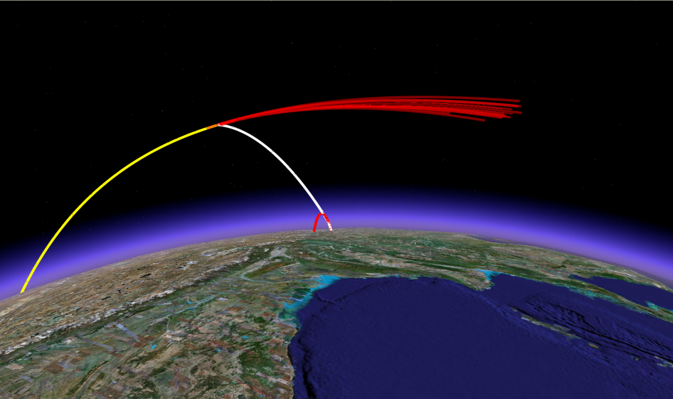
How is Space a Territorial Issue?
Sovereign states lay claims
Need recognized control
Border disputes like Kashmir
Military security concerns
Economic benefits
Satellites, space travel, junk removal, in-space repairs
¤
http://web.mit.edu/stgs/spaceprograms.html

Slide 5
Why a Transnational Issue?
Affects everyone
Sovereign states’ self-interests clash
Territorial claims, but limited
Debris
Satellites, Int’l Space Station, space travel
Security
Economic interests
Communication potential
Need IL to coordinate
¤

Slide 6
How to address?
As TI, need cooperation
Self-interested actors
Agree on IL?
Who pays?
Who enforces?
Lack of cooperation =
Military usage/threats
Lots of junk
Ownership claims
¤

