Slide 1
The State

Slide 2
Sovereignty

Slide 3
United Nations Security Council
P5 + 10 = 15
Rotating seats
Issues
Veto power
Lack of meaningful representation
Difficult to reform
¤
http://www.bbc.com/news/world-middle-east-24580767

Slide 4
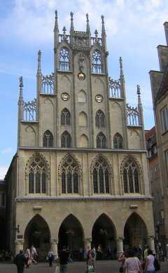
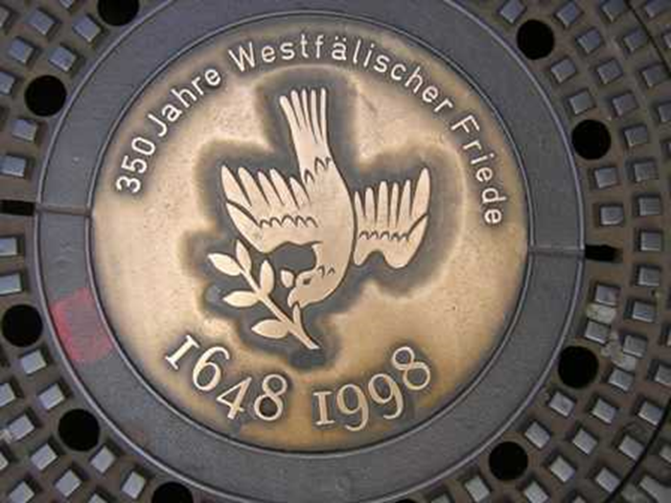
The Beginning
Why is this building, the
Friedensaal, significant
to international relations?
Treaty of Westphalia (1648)
Ended 30 Years’ War
¤

Slide 5
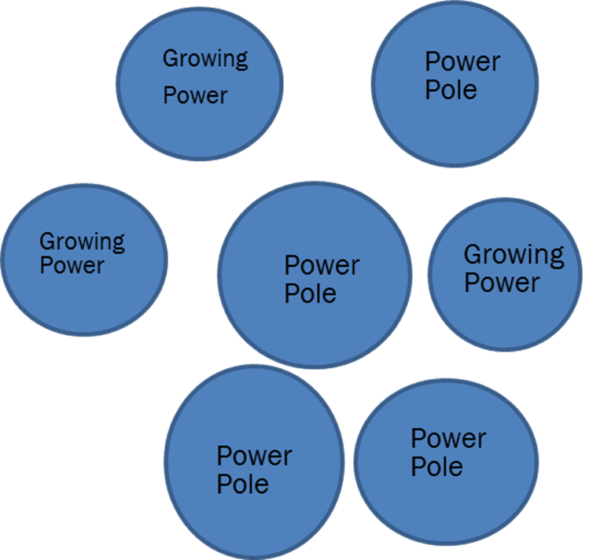
Treaty of Westphalia-1648
3 things came out of the Treaty:
Sovereignty→
States→
System
Multipolar system
4+ power poles
Tried to balance power
Cold War (post WWII-1991)
Only time not multipolar
Bipolar system, two superpowers
United States v. Soviet Union
¤

Slide 6
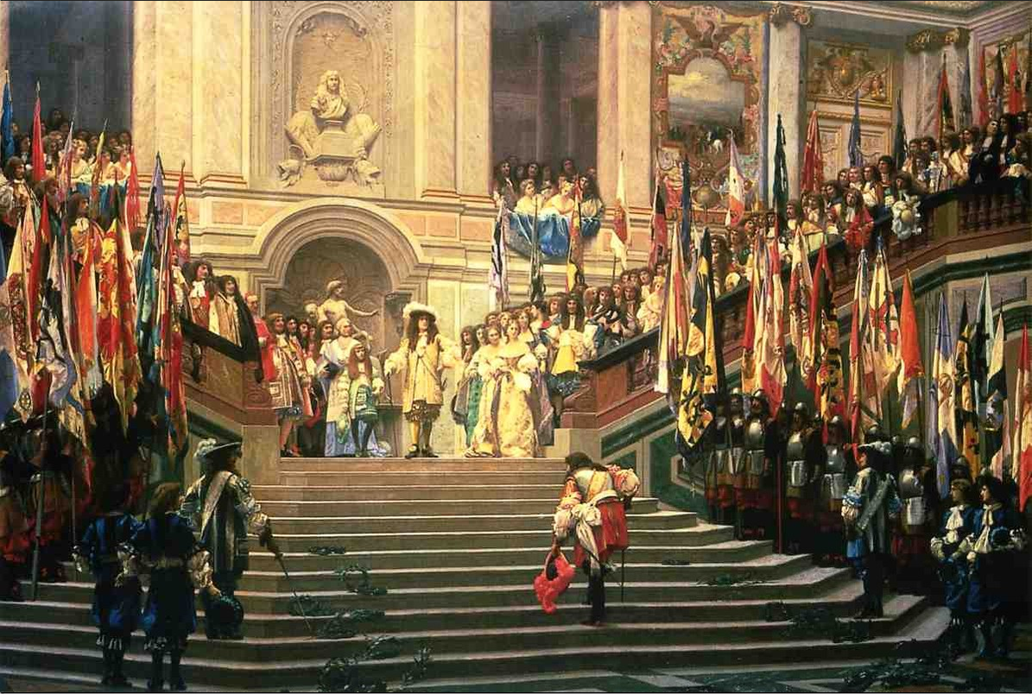
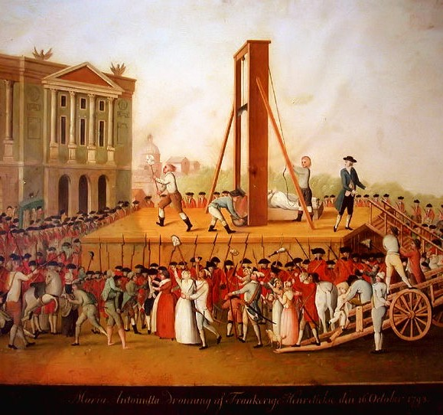
Rise of Popular Sovereignty
Raison d’état (‘Requirements of the State’)
Divine Right of Kings
Challenges to raison d’état
‘Popular’ sovereignty
American, French Revolutions
http://dm-fa.org/academic/gerome2.html#11
http://www.npr.org/blogs/thesalt/2012/07/13/156722719/let-them-eat-kale-vegetarians-and-the-french-revolution

Slide 7
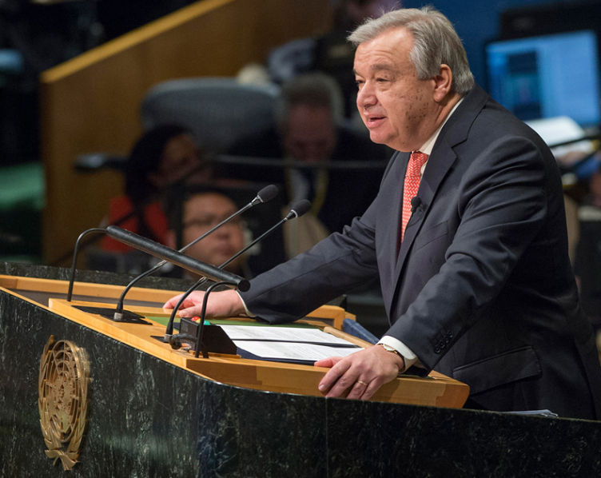
About The United Nations
Post WWII to promote peace
UN is an intergovernmental organization (IGO)
193 members
UN General Assembly
UN Secretary General
Grant states sovereignty
Principle of self-determination
Pre- WWII, earned
Post-WWII, granted
¤
António Guterres

Slide 8
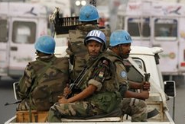
UN Benefits
Benefits of membership
Sovereign recognition
Aid
Trade
Collective security
Peacekeeping
Peacemaking
Peacebuilding
Lots of agencies
Tackle transnational issues
¤
I800 C monitors http://www.bbc.co.uk/news/world-africa-18379696
http://www.telegraph.co.uk/news/worldnews/europe/bosnia/11729436/Srebrenica-20-years-on-What-have-been-the-successes-and-failures-of-UN-peacekeeping-missions.html

Slide 9
State Sovereignty Recap
Treaty of Westphalia
Sovereignty v. popular sovereignty
Composition of the UN
Unhappy with UNSC
Benefits of membership
Collective security
¤

