Slide 1
The Environment

Slide 2
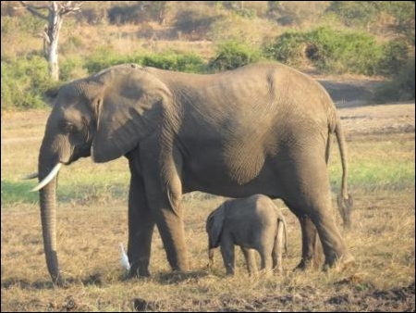
Managing the Environment
Transnational Issue
Multifaceted
Air, land, sea
Flora, fauna
Economic, cultural factors

Slide 3
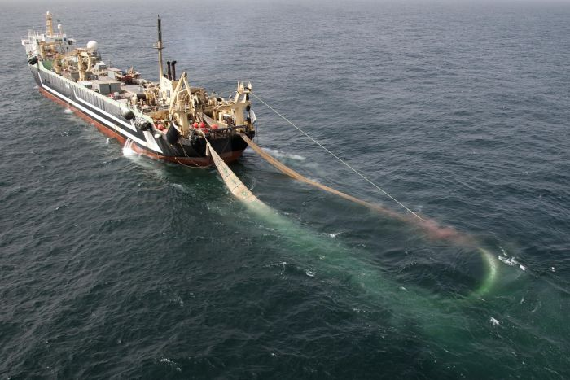
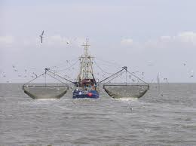
Collective Good
Shared resources
Free riders→ tragedy of the commons
Transnational issue
Space junk
Tuna
Sustainable development

Slide 4
How many paper towels do you use to dry your hands?

Slide 5
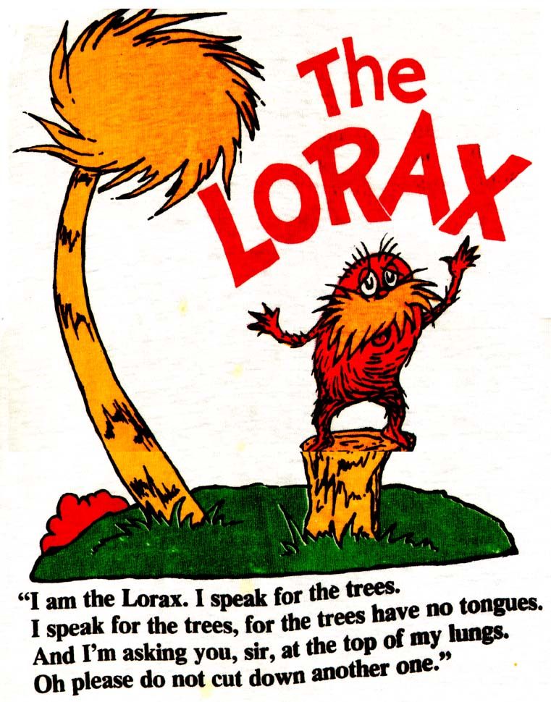
The Beginning
When did people start to care?
Materialism v. post-materialism
2021 Global Climate Strikes link
¤

Slide 6
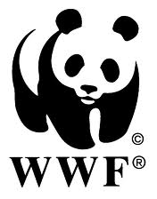
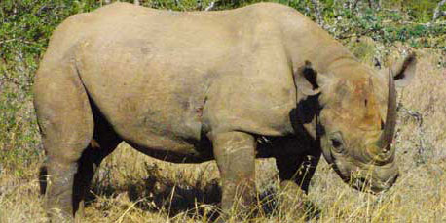
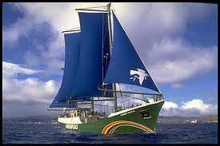
Brief History: NGOs
World Wildlife Fund (WWF) (1960)
Earth Day (1970)
Greenpeace (1971)
EarthWatch Institute (1971)

Slide 7
Which is less harsh on the environment?
a) Paper bags
b) Plastic bags

Slide 8
Plastic Bags- 80% people choose
Circle globe 63 times
1-3% recycled
Paper Bags- 20 % people choose
14 M trees/yr
10-15% recycled
Best options: Reusable or no bag

Slide 9
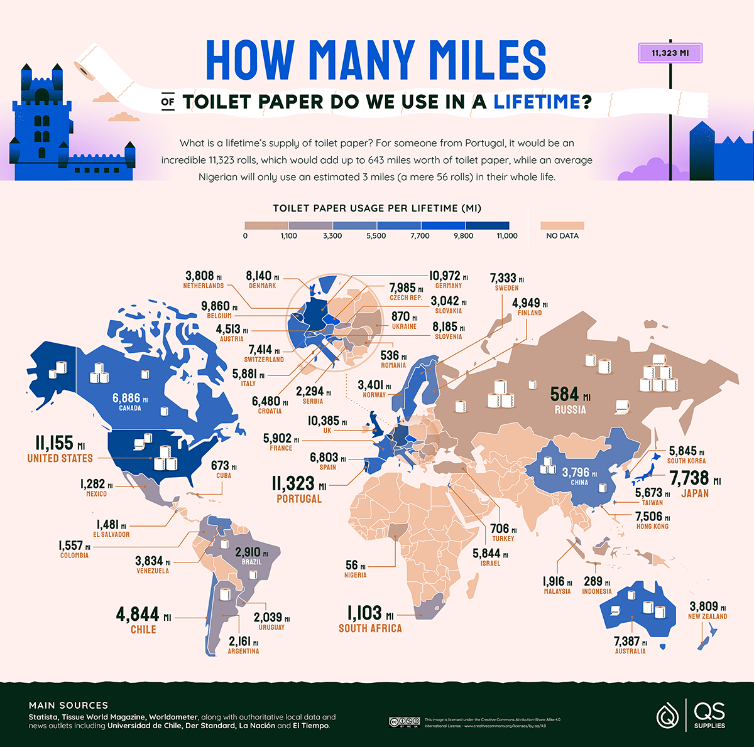
https://files.qssupplies.co.uk/world-toilet-paper-visualised/07_Loo-dicrous-Loo-Roll_World-Map_miles.png

Slide 10
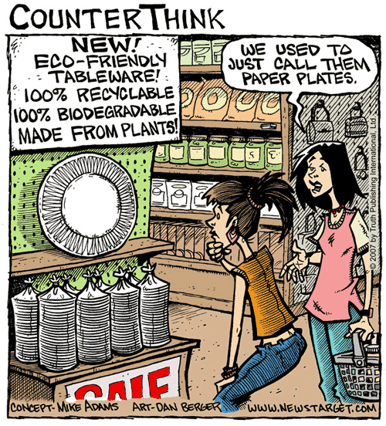
Brief History: MNCs
Economic incentive
Trade-up programs
Planned obsolescence
Consumer demands
Green practices
Ethically-sourced products (fair trade)
Going green v. ‘greenwashing’
¤
http://planetthrive.com/2007/11/greenwashing/

Slide 11
Fast Fashion
Now, ultra-fast fashion
Wear clothes 40% < time
24 lb/yr per person =85% of textiles/yr to landfills = 262,500 elephants
1 cotton shirt= what one person drinks in 2.5 years
Cost-per-wear
EU pushing for sustainability requirements
Durable, reusable, ban destroying unsold textiles, labeling
Solutions?
‘Slow fashion’- Cut back 75% & recycle clothing (v. landfill)
Rentals, exchanges, secondhand
Circular economy
Ethically source materials and labor
¤

Slide 12
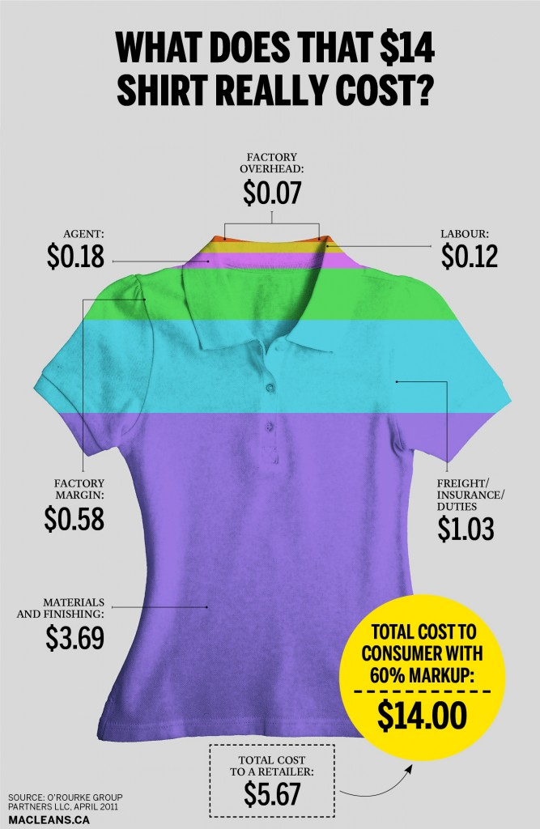
Value v. Cost
Price
Profit
Value
Exploitation
Workers
Planet
MNCs
¤
https://www.macleans.ca/economy/business/what-does-that-14-shirt-really-cost/

Slide 13
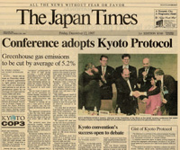
Brief History: IGOs
UN Environment Programme (UNEP)
Stockholm Conference (1972)
Rio + 20 (2012)
Sustainable development goals
UN Conventions
Kyoto Protocol (1997)
Minamata (2013)
Paris Agreement (2016)
¤

Slide 14
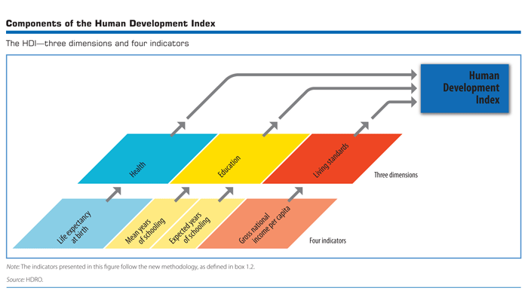
Achieving Security
Human Development Index→ social & econ. dev.
Institutions
Infrastructure
http://hdr.undp.org/en/statistics/hdi/

Slide 15
Brief History: IGOs
World Bank
Late 1980s/ early 1990s
Millennium Development Goals
Comprehensive Wealth Accounting
Economic Capital
Human Capital
Natural Capital
Sustainable Development

Slide 16
Do you turn off the water while brushing your teeth?

Slide 17
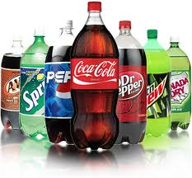
Tap runs ~2.5 gal/minute
Same as drinking 80 - 2 liter bottles of soda / week
What water is better: Bottled or tap?
EPA testing
33% of bottled water w/ contaminants

Slide 18
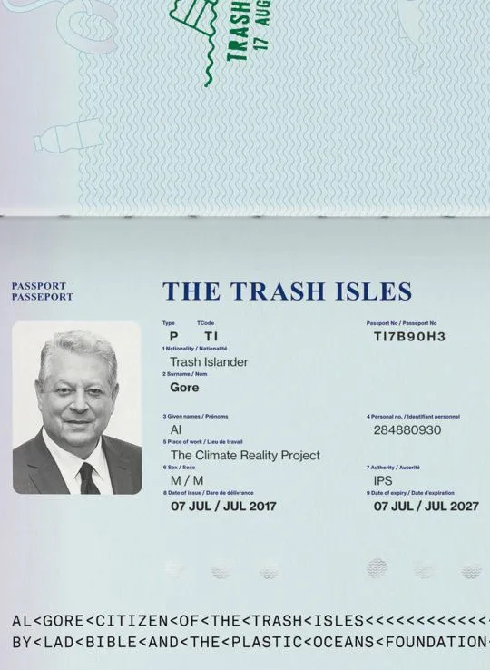
Great Plastic Garbage Patch link
https://www.architecturaldigest.com/story/al-gore-wants-to-be-first-citizen-of-proposed-nation-made-of-floating-trash

Slide 19
What countries generate the most waste?

Slide 20
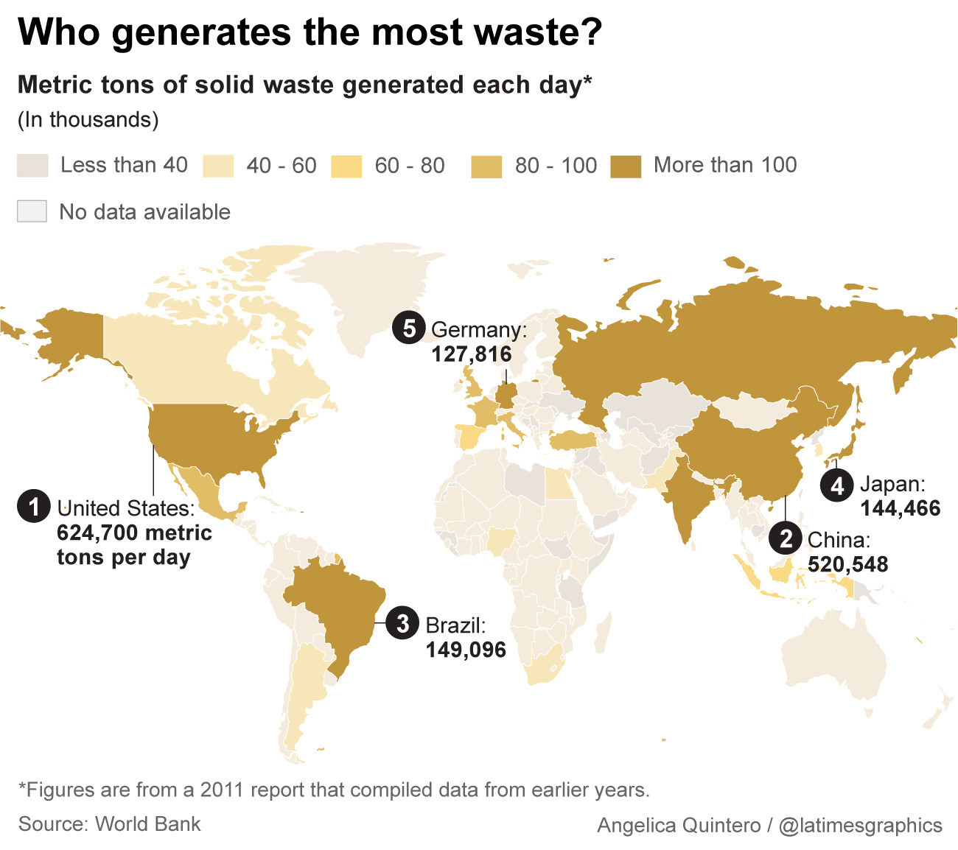
http://www.latimes.com/world/global-development/la-fg-global-trash-20160422-20160421-snap-htmlstory.html

Slide 21
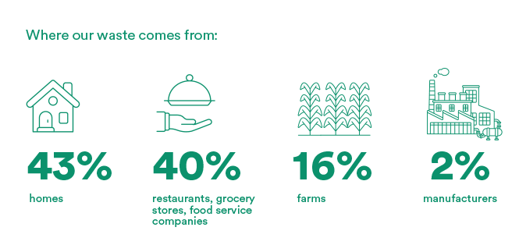
Food Waste Facts: US
1/3 of all food produced wasted= 1.4 BT = $1 T/yr
US = most food waste in world
In GN- 30-40% in trash = 650 apples right into garbage
In GS- getting to market, lack of proper storage
Wastes water, ag inputs, cropland, landfill space
Labeling and donation confusion
https://www.rts.com/resources/guides/food-waste-america/

Slide 22
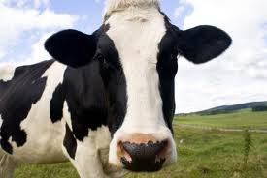
Dietary Choices
Organic
Myth that it is better than conventional
Local
Myth that it is better than imported
Food miles
Reduce meat consumption
Myth that grass-fed is better for the planet
All ruminants have carbon impact
Dairy comes from them
Lots of chickens die in transport
Better for your health
Fair trade
Not a myth- it’s a better choice
http://diaryofanutritionist.com/2010/01/21/milk-fit-for-the-cow-calf/

Slide 23
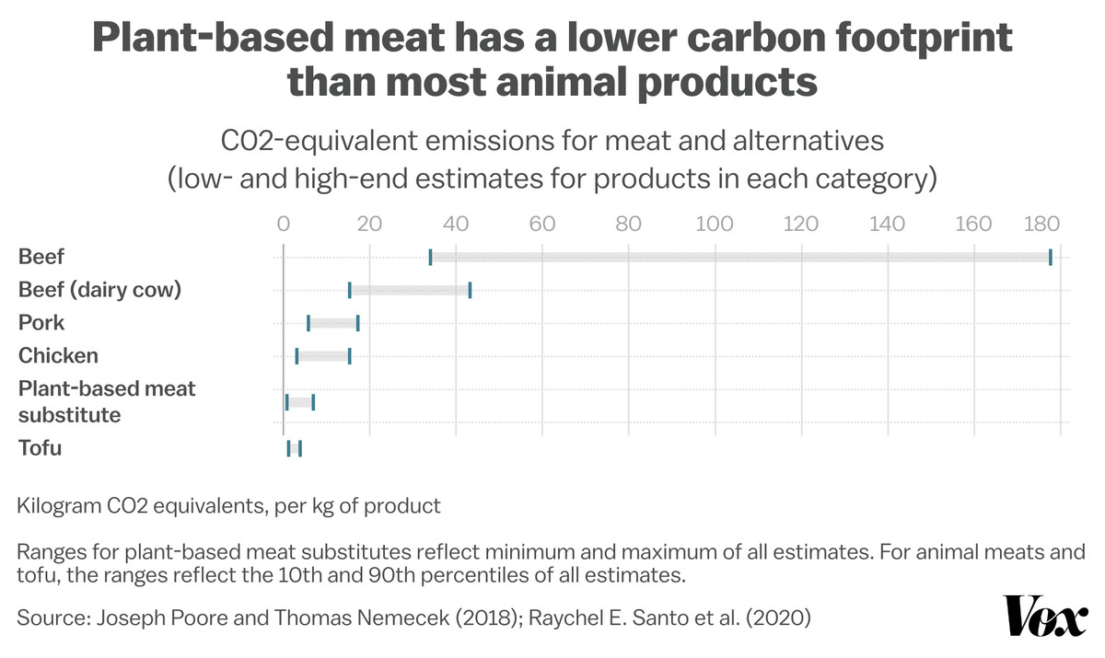
https://www.vox.com/future-perfect/22905381/meat-dairy-eggs-climate-change-emissions-rewilding

Slide 24
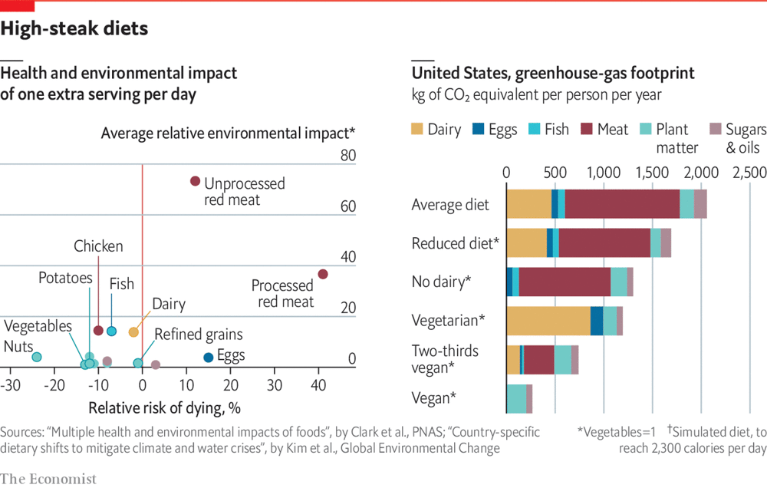
https://www.economist.com/graphic-detail/2019/11/15/how-much-would-giving-up-meat-help-the-environment

Slide 25
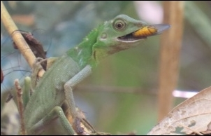
Eat Bugs!
Entomophagy
UN-backed
Efficient source of protein
Steady food supply
Ick! Factor
¤

Slide 26
Marine Protected Areas
Economic
Commercial pressure
Other states, MNCs
Lack of resources in Indonesia
Env.
Overfishing
Deforestation→ pollution
Threatens biodiversity
Climate change
IL
Enforcing MPA policies
Req. cooperation
WWF- NGO
Regional states
Fishing states
¤

Slide 27
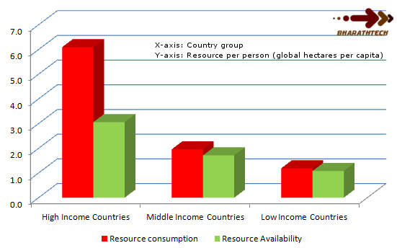
The Future
Approaches
‘Band-Aid’ solution
Cooperation & conservation
Self-interested actors
Climate change = #1 concern
-Resource usage is unsustainable
-Humans are depleting resources too quickly
http://www.bharathtech.com/2012_02_01_archive.html

Slide 28
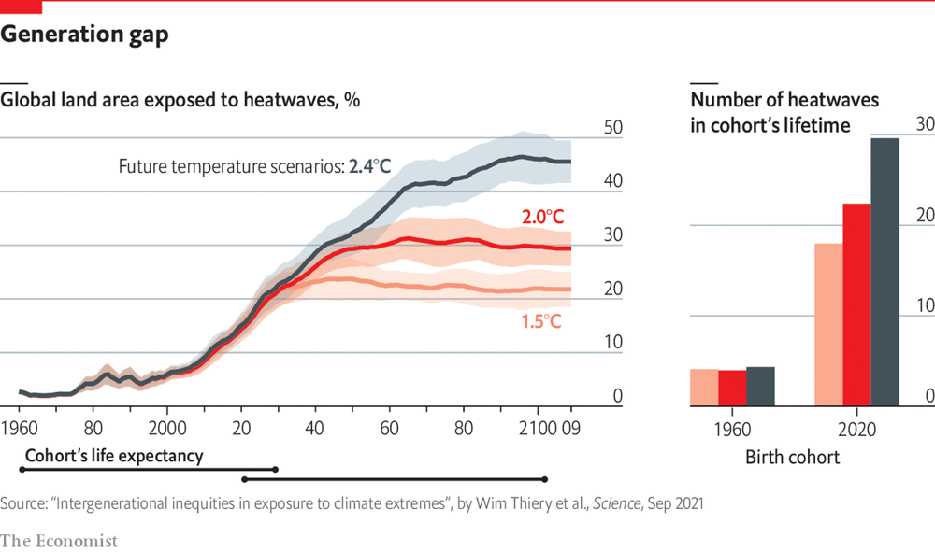
https://www.economist.com/graphic-detail/2021/09/28/children-born-today-are-likely-to-face-seven-times-more-extreme-weather-events-than-their-grandparents

Slide 29
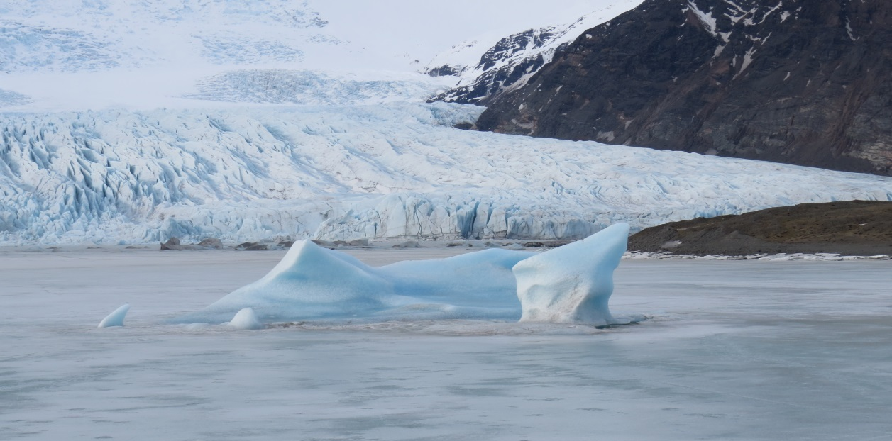
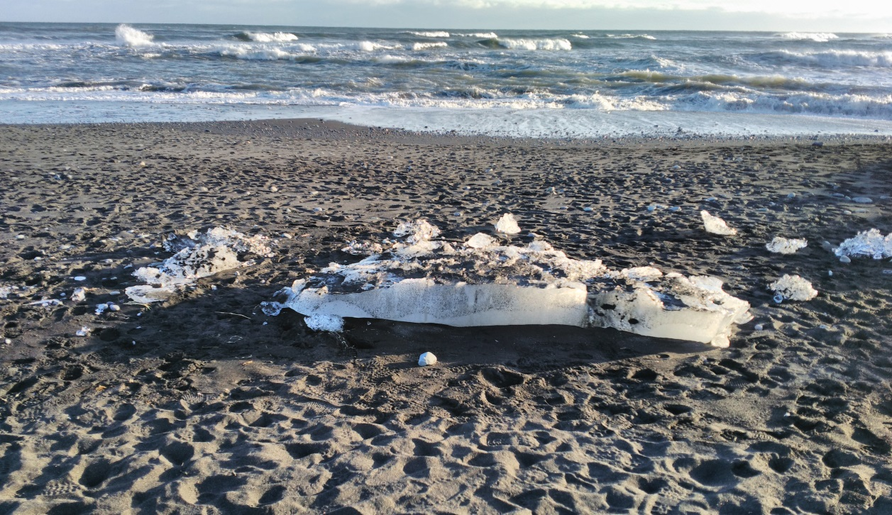
Glacial Melting
Antarctic Sea-Ice Extent
https://www.economist.com/graphic-detail/2023/02/20/sea-ice-in-antarctica-is-at-its-lowest-ever-level-again

Slide 30
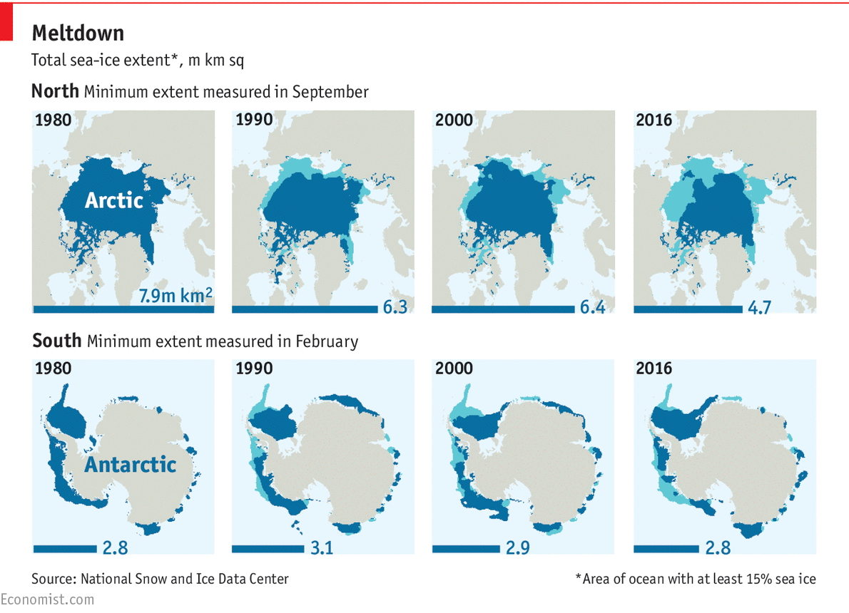
The Future
http://www.economist.com/blogs/graphicdetail/2016/11/daily-chart14?cid1=cust%2Fddnew%2Fn%2Fn%2Fn%2F20161123n%2Fowned%2Fn%2Fn%2Fnwl%2Fn%2Fn%2FNA%2F8198389%2Femail&etear=dailydispatch

Slide 31
How many single-use, disposable items do you use yesterday?

Slide 32
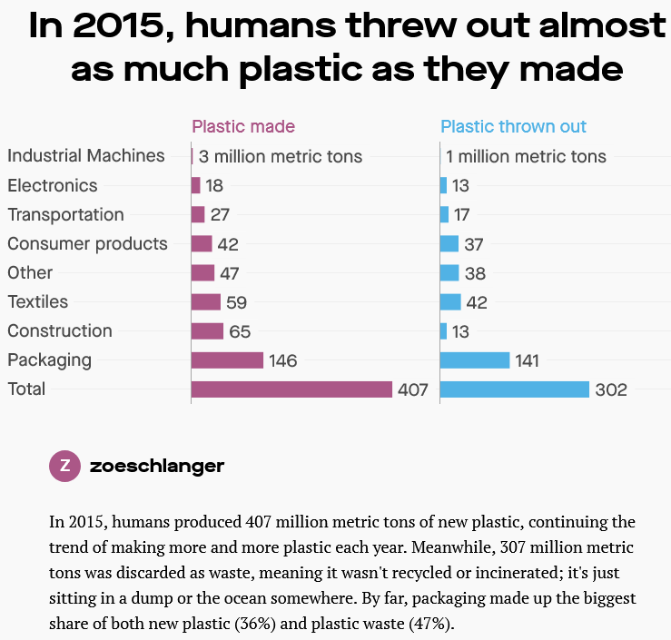
https://theatlas.com/charts/SyPmBlTSZ

Slide 33
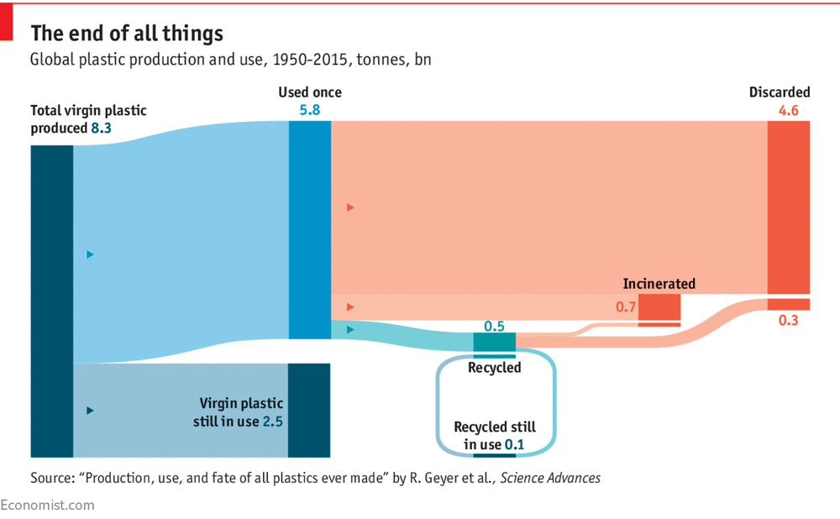
https://www.economist.com/graphic-detail/2018/03/06/only-9-of-the-worlds-plastic-is-recycled

Slide 34
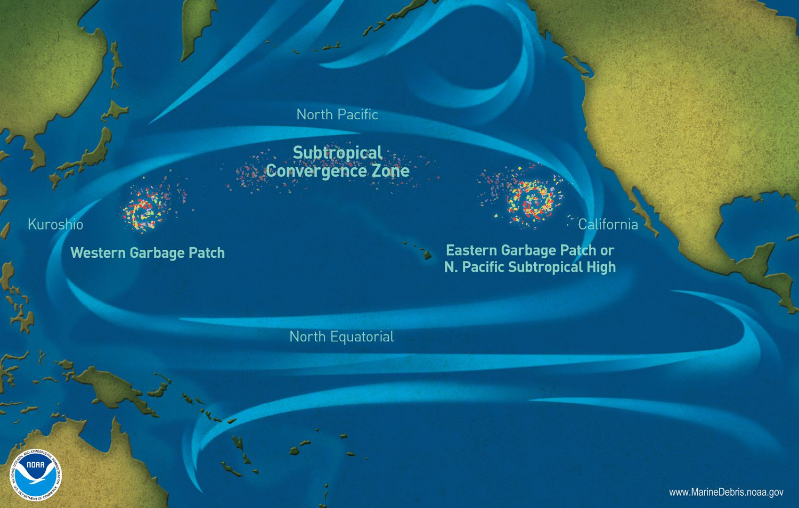
Your Impact on the Future
Personal consumption choices
Consumer goods
Source of products
Food
Waste link
Reduce, reuse, repair, repurpose v. recycle
Self-interests v. future survival
¤

Slide 35
Environment Recap
Collective good
Multifaceted, transnational issue
Recent int’l interest
Main actors
Personal consumption choices
‘Low-hanging fruit’ changes
Self-interests v. future survival
Need for int’l cooperation v. st. sovereignty
¤

