Slide 1
Diplomacy & Negotiation

Slide 2
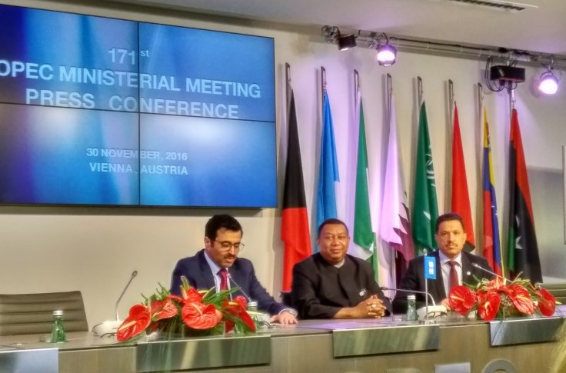
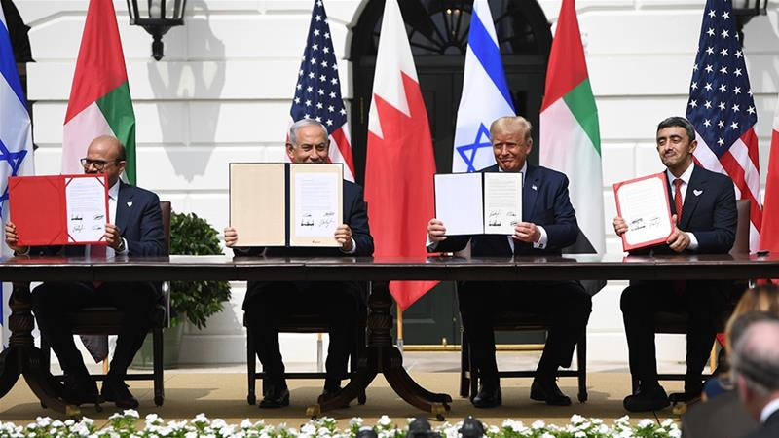
Its Roots
Modern era began
Treaty of Versailles, 1919
Objective
Promote/preserve self-interest
OPEC oil cartel
Saudi Arabia v. Iran
OPEC+ Russia
Formal relations bt. states
Must be sovereign to engage
Head of government is chief diplomat
Recognize with an Embassy
¤
http://www.ibtimes.co.uk/opec-agrees-cut-oil-production-by-1-2m-barrels-per-day-1594255
https://www.aljazeera.com/news/2020/09/breaking-taboo-uae-bahrain-sign-deals-israel-200915143203968.html

Slide 3
Negotiation Environments

Slide 4
Negotiation Environments
Hostile Diplomacy
Armed/potential armed
Yemen
Adversarial Diplomacy
Little chance of conflict
AUKUS
Coalition Diplomacy
Cooperation to solve issue
Arms Trade Treaty
Mediation Diplomacy
3rd party in stalemate
Iran
Other examples?
Peloponnesian War
Hostile
Outer space issues
Coalition
Eurozone crisis
Adversarial
Manchego cheese name
Adversarial
Kashmir
Hostile
Gaza Strip
Hostile
The EU
Coalition
Sanctions on Russia
Coalition, Adversarial

Slide 5
Diplomatic Pacts

Slide 6
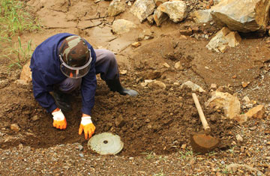
Negotiating Security Pacts
Bilateral
Finland & Sweden, US & S Korea
Multilateral- NATO, AU, UN, AUKUS
Antipersonnel Mine Treaty
161 signed- Russia, China didn’t
U.S. → sign w/ Korea exception
UN Arms Trade Treaty (ATT)
Nuclear, chemical, biological weapons conventions
Intermestic issues
States must balance
¤
http://www.rainbowfund.org/landmines/

Slide 7
Diplomacy & Negotiation: Recap
Diplomacy
What it is
Who can engage in it
State qualities affect negotiation power
Negotiation environments
Negotiation leverage varies
States create security pacts
States balance domestic and int’l interests
¤

