Slide 1
Security & Cooperation: Threats

Slide 2
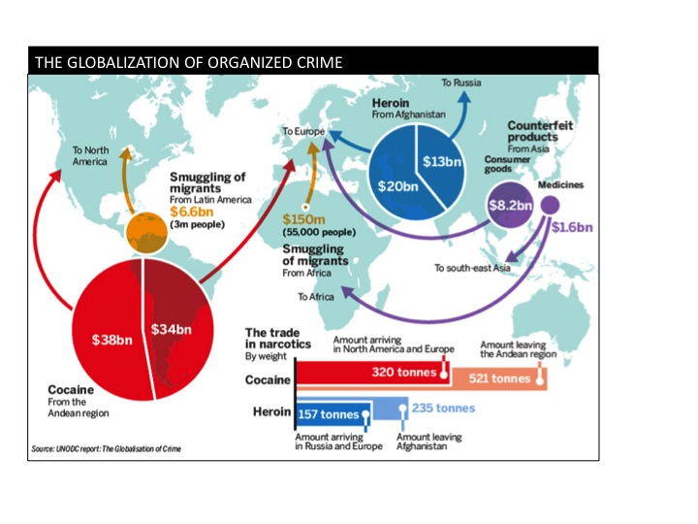
Transnational Crime
Crosses national boundaries
Piracy
Cybercrime
Money Laundering
Trafficking
Demand = supply
¤
http://www.infosources.info/article.php?aid=411

Slide 3
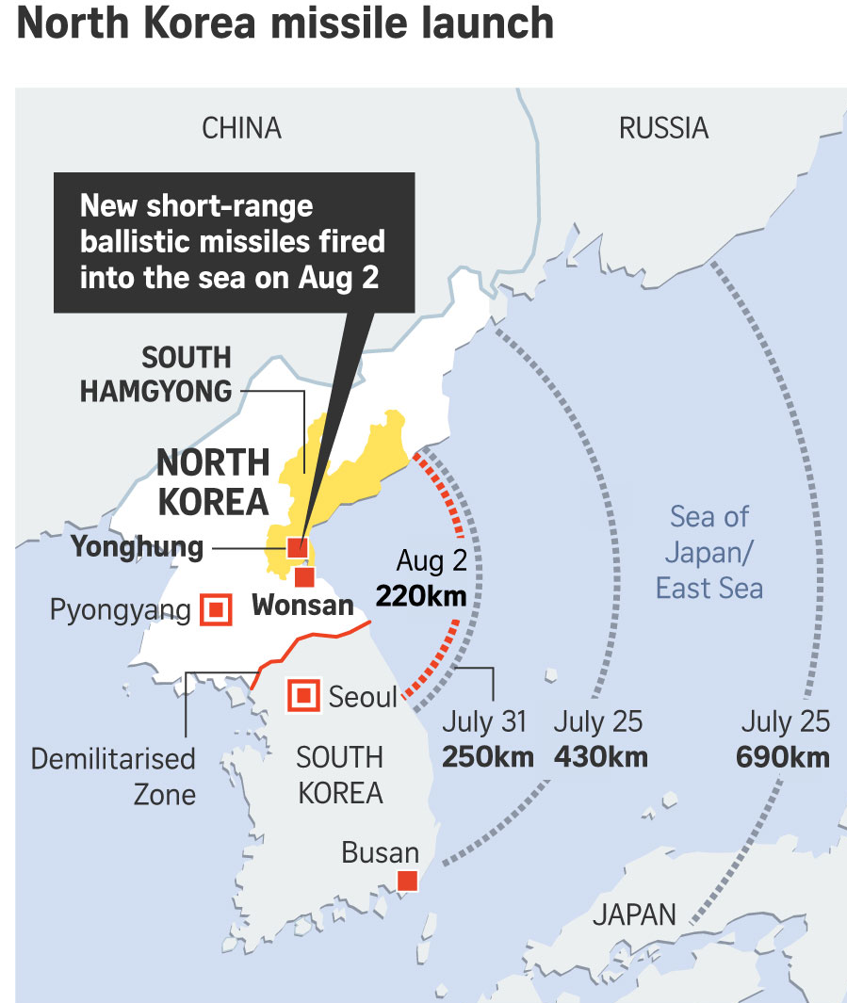
Weapons
↑ arms transfers
Cold War, post-CW
UN ATT proposal
↑ technology
N. Korea, Iran
Cyber attacks
¤
Rank | Supplier | Arms sales
1 | U.S. | $10.7 b
2 | Russia | $4.7 b
3 | France | $3.4 b
4 | China | $1.4 b
5 | Germany | $1.2 b
7 | U.K. | $97 m
http://armstrade.sipri.org/armstrade/page/toplist.php
https://www.straitstimes.com/asia/east-asia/new-north-korea-projectile-launch-detected-us-official

Slide 4
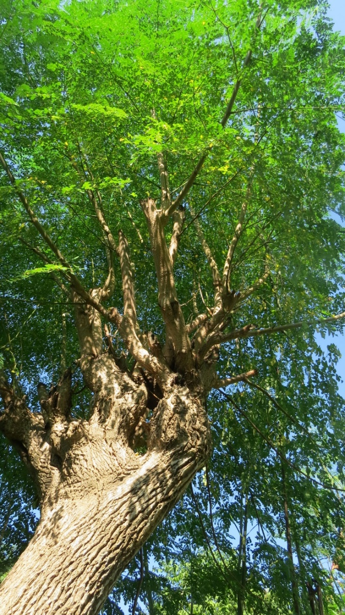
Rosewood Trees
Economic
Poverty, easy way to make quick money
Corruption
Chinese demand
Environmental
Impact on the ecosystem
Extinction of rosewood trees
Political
Illegal cutting across borders
Self-interested states
Requires cooperation
Hard to enforce IL
¤

Slide 5
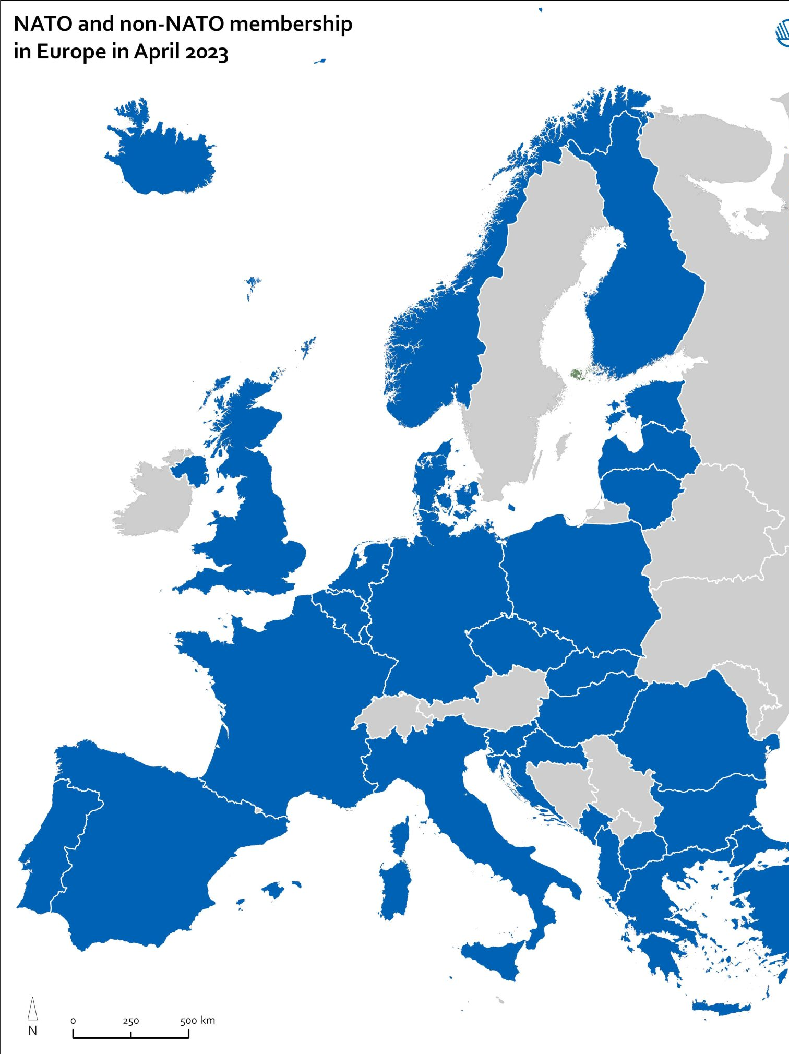
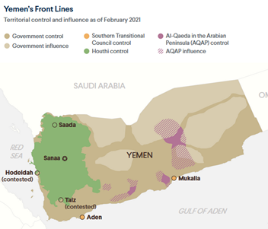
Aggression
Russia → Ukraine
China → South China Sea
Saudi Arabia, Iran → Yemen
North Korea
¤
https://nordregio.org/maps/nato-and-non-nato-membership-in-europe-in-2023/
https://www.cfr.org/backgrounder/yemen-crisis

Slide 6
Crystal Insecurity
Economic
Consumer craze
Ironically, biggest market is wellness industry
Consumers disconnected from producers
Little concern for provenance, supply-chain details
By-product of big industry mining
Environmental
Non-renewable resource
not sustainable
Mining is dirty and destructive
¤

Slide 7
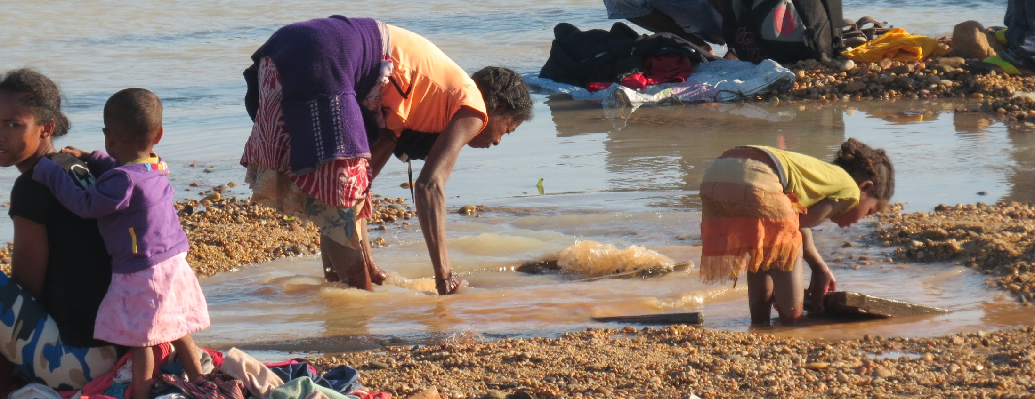
Crystal Insecurity (cont.)
Political
Support conflict, oppressive regimes
Lack of mining regulations
Labor conditions, pay, children

Slide 8
Crystal Insecurity (cont.)
Political
Support conflict, oppressive regimes
Lack of mining regulations
Labor conditions, pay, children

Slide 9
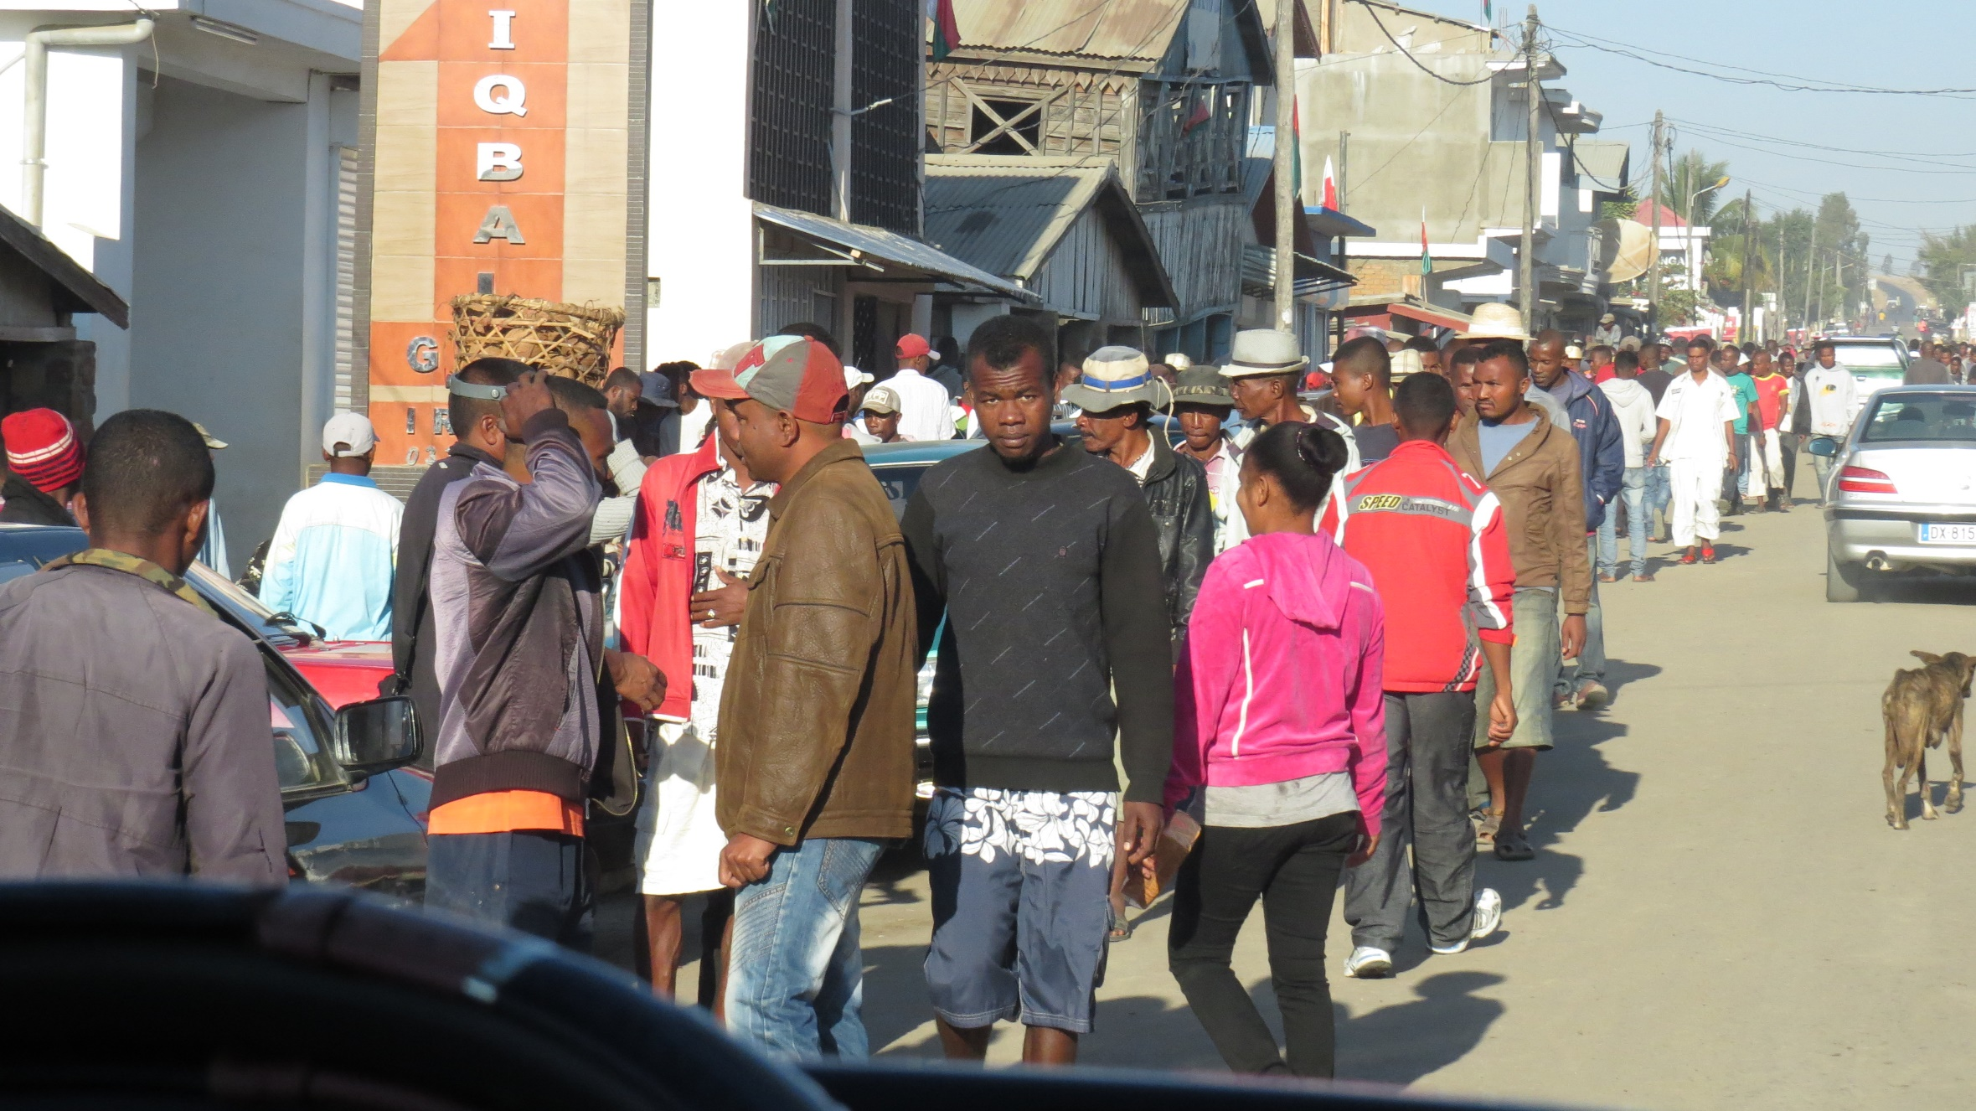
Crystal Insecurity (cont.)
Political
Support conflict, oppressive regimes
Lack of mining regulations
Labor conditions, pay, children
Environmental protections
NGOs→ awareness, regulation

Slide 10
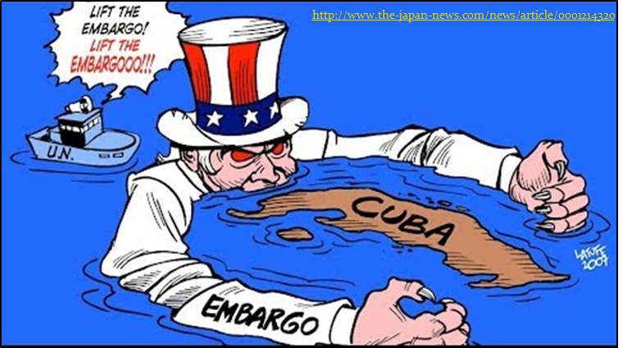
Sanctions
What are they?
Can be economic, political
Boycott, embargo, aid, assets, etc.
Why are they used?
Push for change
Political sanctions
Embassy, travel, sports
¤

Slide 11
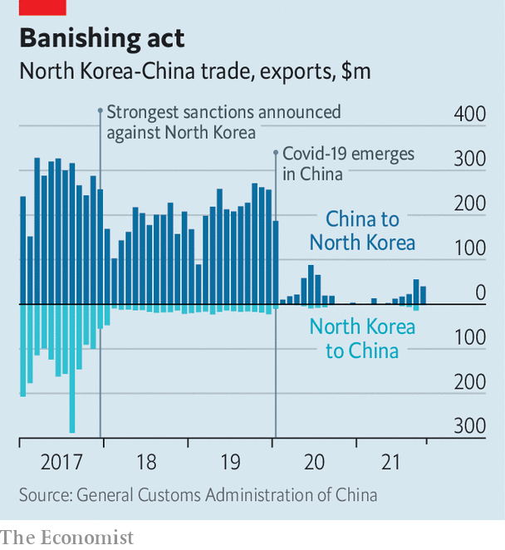
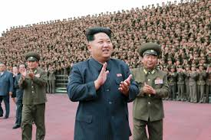
Sanctions: North Korea
UN Resolution 2270 (2016)
Sanction violations by China
Coal exports link, oil imports link
NK workers
Earn abroad; most to NK gov’t
Goods exported to US
China’s concerns link
Shared border
Missile tests
Assassinations
Trade
¤
https://www.economist.com/asia/ten-years-into-kim-jong-uns-rule-north-korea-is-more-north-korean-than-ever/21806770?
http://time.com/4067670/north-korea-kim-jong-un-award-indonesia-sukarno/
http://www.bbc.com/news/world-asia-35835088

Slide 12
Sanctions: Russia
First after Crimea invasion
Endlessly increasing list for Ukraine aggression
Political, economic, cultural
Target oligarchs, political leaders/family members
Difficulties
Challenge to cut off so quickly
Don’t want to break laws
Ex.- MNCs with franchises in Russia
Not all countries on board
‘Back-filling’
Hurting population
¤

Slide 13
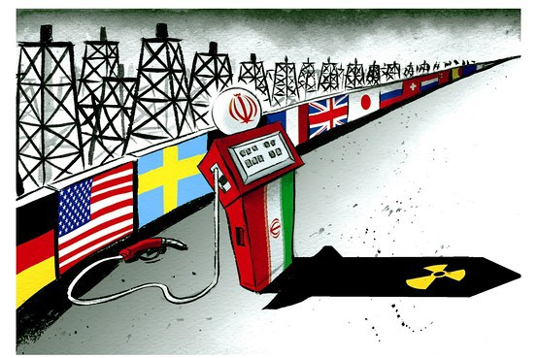
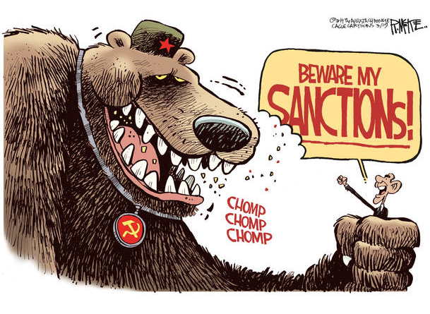
Sanctions Recap
Effectiveness
U.S. → Cuba
E.U., U.S. → Russia
Global, unilateral
Iran
N. Korea
¤
https://iran2407.wordpress.com/author/iranuclear/page/13/
http://themillenniumreport.com/2014/07/nine-eu-countries-to-block-economic-sanctions-against-russia /

Slide 14
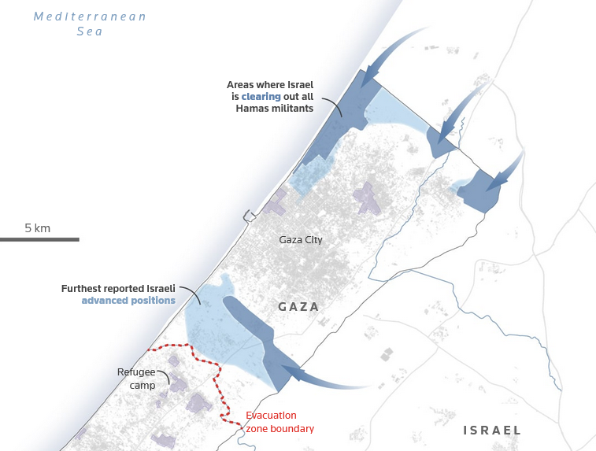
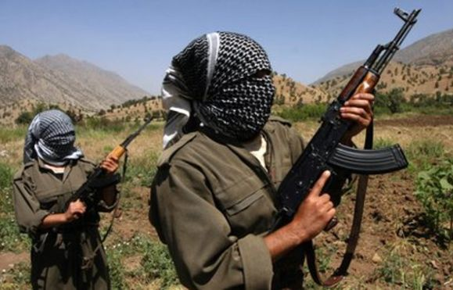
Terrorism
https://www.reuters.com/graphics/ISRAEL-PALESTINIANS/MAPS/movajdladpa/cdn/images/graphics/isw-nov5-md.jpg
Instill terror in civilians
Motivation
Political, religious, ideological
Colonization, westernization
Attention, challenge gov’t
Independence
Domestic terrorism
Freedom fighters v. terrorists
Israel → Gaza Strip
¤
Kurdish Worker’s Party (PKK)
https://espresso.economist.com/9f5a14374960400c7f537198d1e26acd

Slide 15
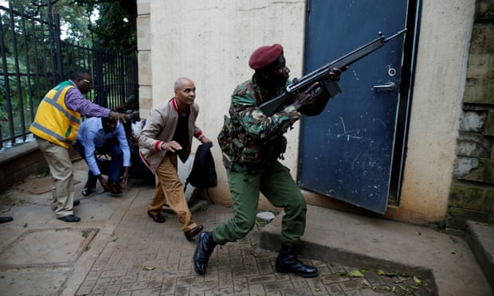
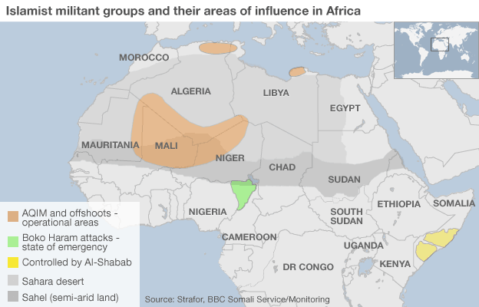
Int’l Terrorism
Organize, attack across borders
al-Qaeda, Boko Haram, al-Shabab, ISIS
State-sponsored terrorism
Iran (Shia) → Hezbollah, Houthis
¤
https://www.theguardian.com/world/2019/jan/15/nairobi-kenya-gunfire-hotel-complex-dusitd2
http://www.bbc.com/news/world-29063111

Slide 16
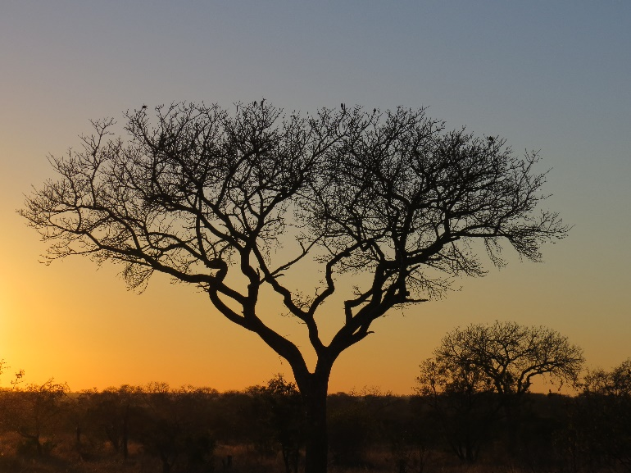
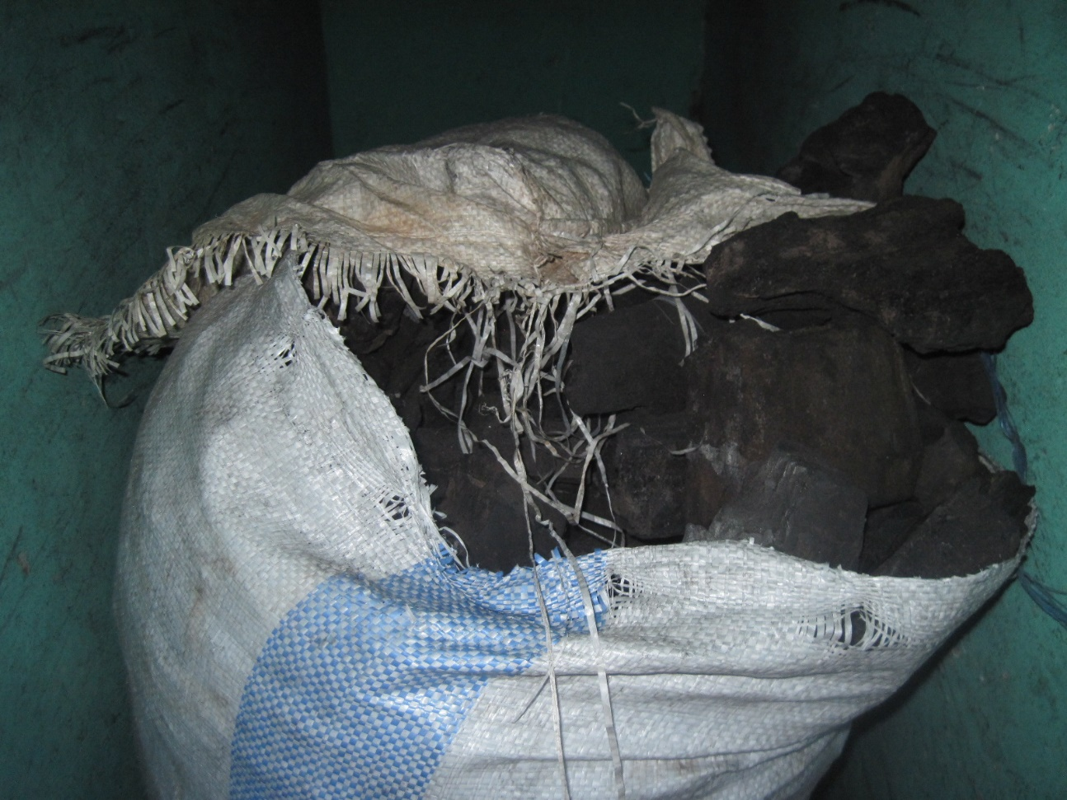
Somali Charcoal

Slide 17
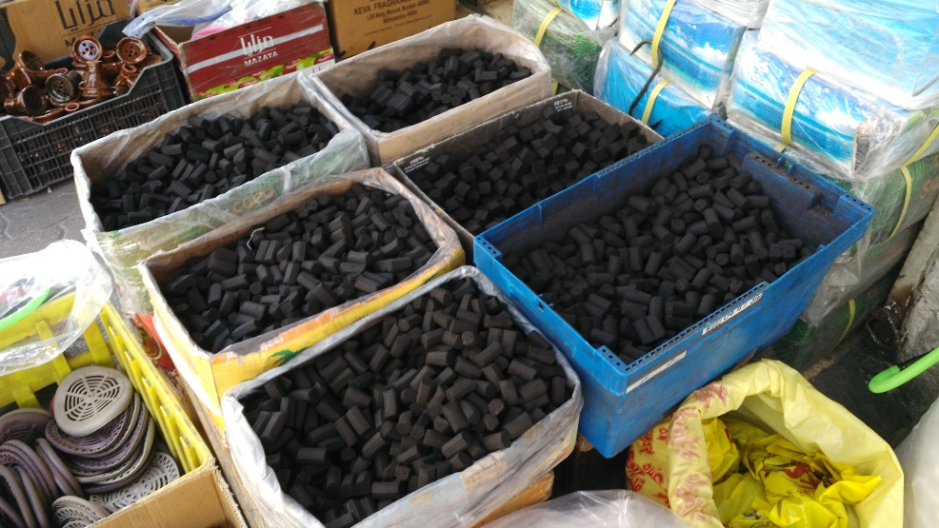
Somali Charcoal

Slide 18
Somali Charcoal
Supply
Need $
Unique charcoal
al-Shabab takes a cut
Support terrorist activities
UN export ban
Weapons from Yemen
Anti-piracy forces
Demand
Gulf states – shisha lounges
Ignore ban
Bottom line: Need cooperation
¤

Slide 19
Similar Situations?
Mangroves
Space Junk
Marine Protected Areas (MPAs)
Rosewood trees
Crystals
Chinese trade w/ N Korea
¤

Slide 20
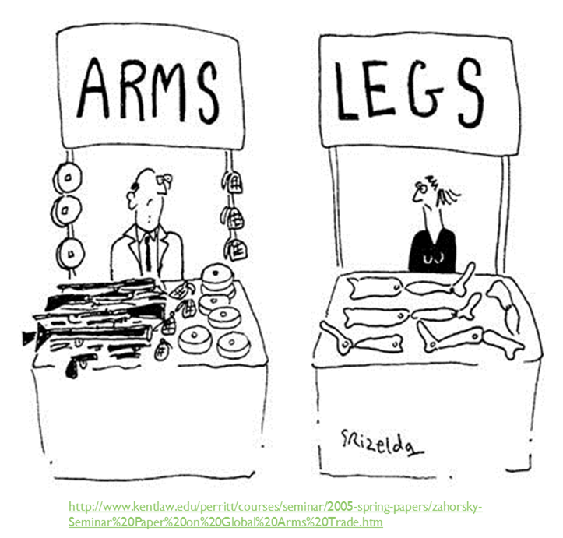
Recap
Fewer wars bt. countries
↑ internal conflict
Seek dominance
Global, regional, internally
Need int’l cooperation
Sanctions
Transnational issues
Crime
Terrorism
Smuggling
Self-interests
¤

