Slide 1
The Basics

Slide 2
System Actors
States
International organizations
Intergovernmental Organizations
Global, regional
Nongovernmental Organizations
Global, regional, national, local
Multinational corporations (MNCs)
Nations
Religious groups
Terrorist networks
Leaders, prominent individuals
¤

Slide 3
Evolution of Economic Divide
European advantage
Industrial Revolution
Colonization
Early on Spain; later UK, France
Cold War
US v. SU → ideological divide
Post-Cold War Era
Economic divide
¤

Slide 4
Global Divide
Global North
32 states (aka countries, but not nations)
Advanced Industrialized Countries
Good standard of living
Average income ~$47,000 in GN source
Global South
162 states (83%)
Most ex-colonies
Standard of living varies
32 Emerging Economies
<$10/day
¤
Country *IMF 2020 | GDP per capita | Status
Sweden | $55,989 | GN- developed
Mexico | $21,363 | GS-Emerging Economy
Nigeria | $6,172 | GS- Average
Burundi | $724 | GS- Very poor

Slide 5
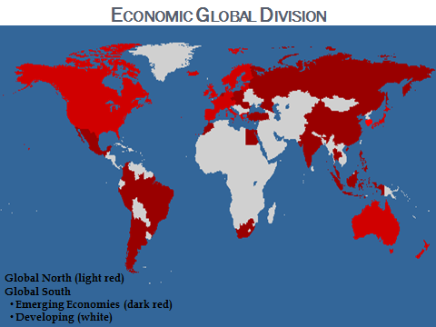

Slide 6
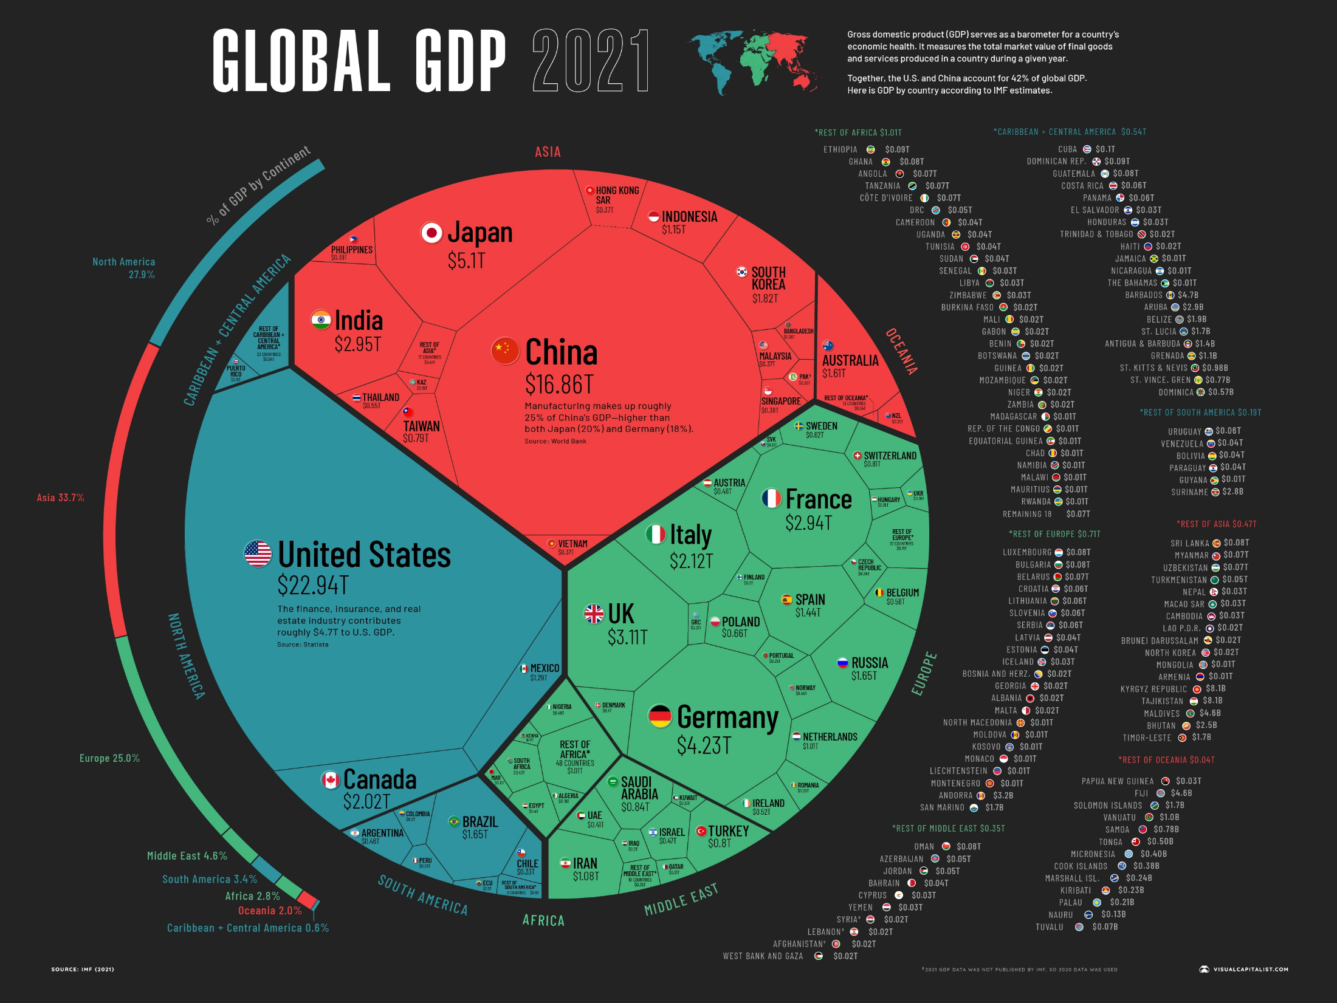
https://www.visualcapitalist.com/wp-content/uploads/2021/12/Global-Economy-GDP-by-Country-2021.html

Slide 7
Economic Activity
Primary goods
Foods, fuels, fibers, minerals, water
Key to GS income
Cocoa bean prices→ next slide

Slide 8
Cocoa Bean Prices
https://www.indexmundi.com/commodities/?commodity=cocoa-beans&months=60

Slide 9
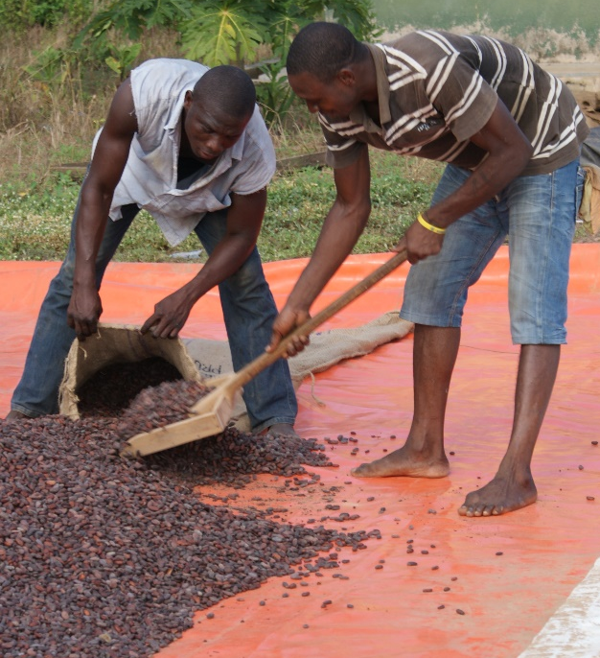
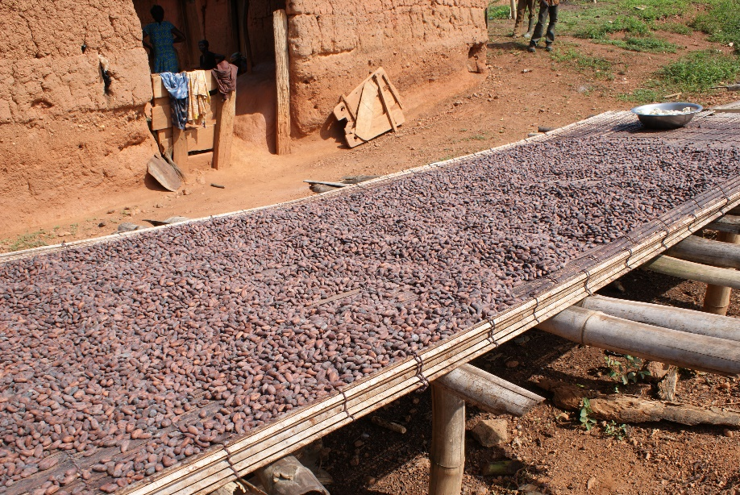
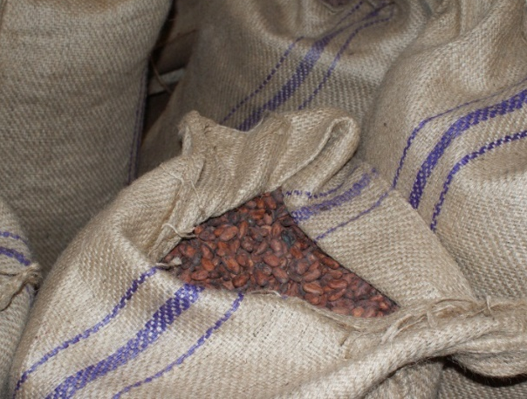
Economic Activity
Primary goods
Foods, fuels, fibers, minerals, water
Key to GS income
Cocoa bean prices→ next slide
Manufactured goods
Finished products
Service industry

Slide 10
Recap
Correlation bt. GDP p/c and standard of living
GN benefits rooted in colonization
Effects of colonization on GS
Most not self-sufficient = wouldn’t be a state w/o UN
¤

