Slide 1
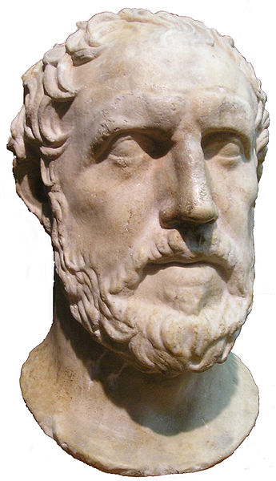
Peloponnesian War
5th Century BCE (431 – 404)
Thucydides

Slide 2
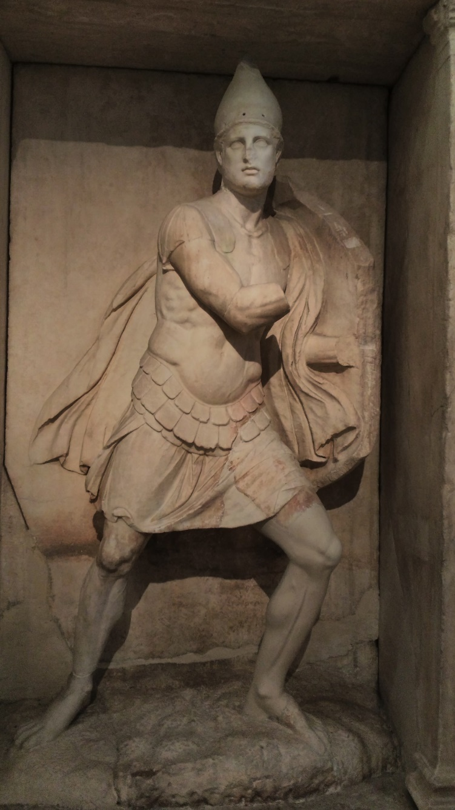
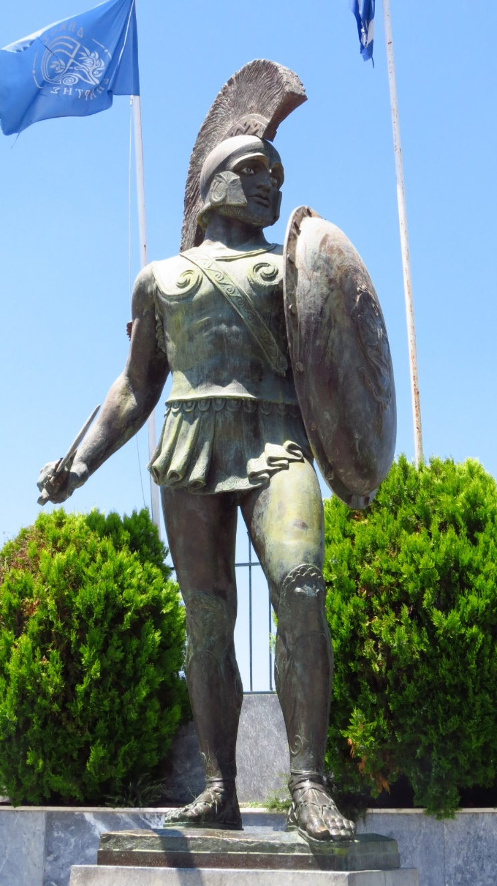
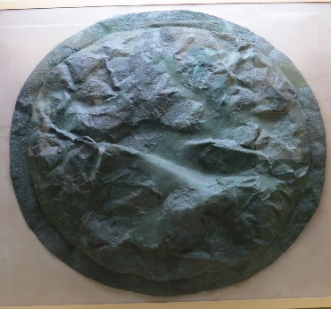
Who’s at War?
Sparta (aka, the Lacedemonians)
Athens
V.

Slide 3
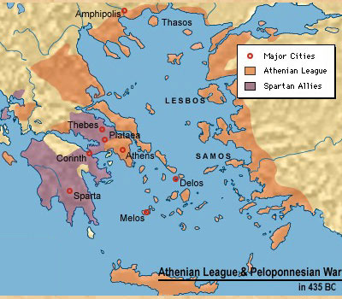
What Island does Athens Want?

Slide 4
Melian Dialogue
Peloponnesian War
Athens v. Sparta
Interests
Power
Security
Strategic point
Economic growth
Control resources
Rationale
Athens: Might makes Right
Melians: Right makes Right
¤

Slide 5
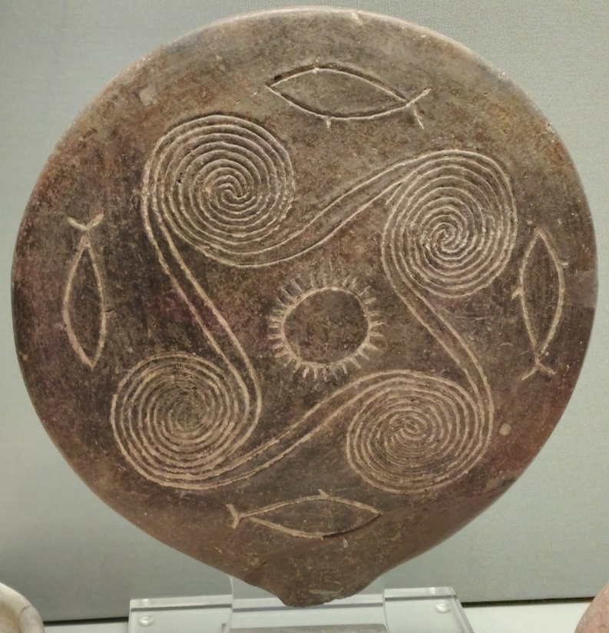
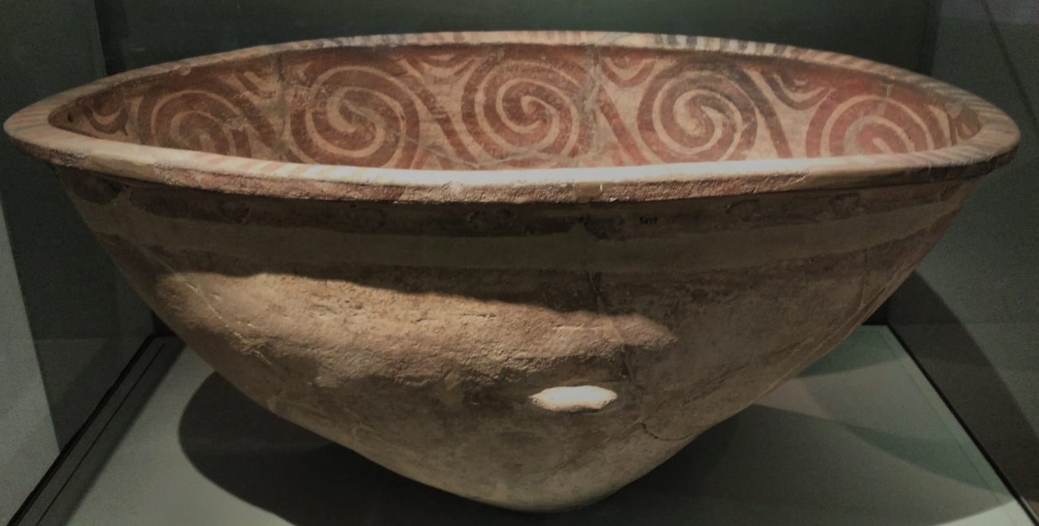
The Melians
Frying pan, c. 2800-2300 BCE
Bathtub c. 2000 BCE
Vase, c. 1600 BCE

