Slide 1
Kashmir

Slide 2
Issues
    Decolonization-
    British leave sub-continent
    Sovereign states- want control
      India, Pakistan, China
      Role of UN (an IGO)
    Territory claims→ conflict
      Kashmir split (LOC, 1949)
      Ladakh split (LoAC, 1962)
    ¤
https://www.bbc.com/news/world-asia-34810086

Slide 3
Issues (cont.)
    Population
      Cultural diff.- esp. religion
      Kashmiris
        ≠ state or nation
    Resources
      Economic benefits
      Nuclear weapons
      Mix of cooperation, conflict
    ¤
https://www.bbc.com/news/world-asia-34810086

Slide 4
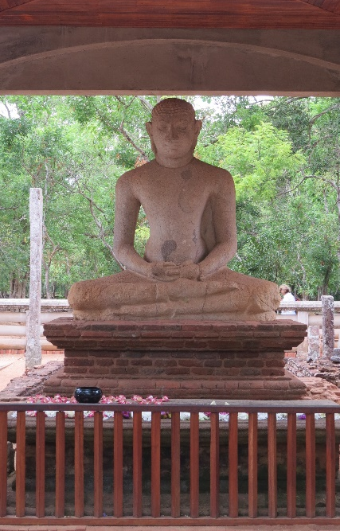
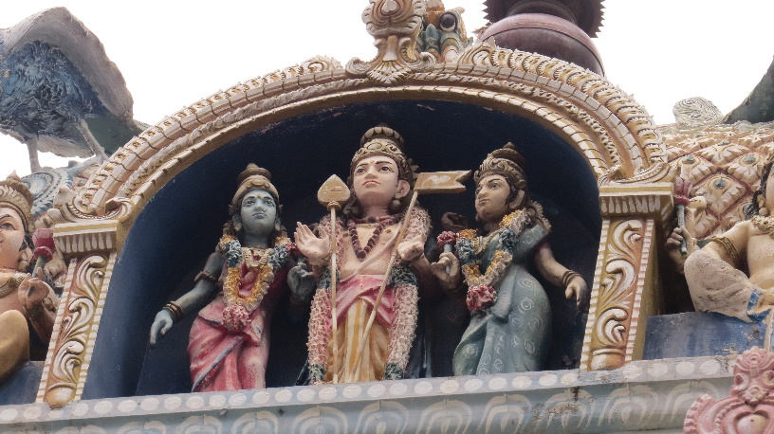

Theories
    Realism
    States: India, Pakistan, China
    Power struggle: Control Kashmir, Ladakh
    Zero-sum: Will lose if concede
Liberalism
    States, but also Kashmiris, UN
    Power struggle, but also about religion, economic benefits, buffer
    + sum: Cooperation would be mutually beneficial
    ¤

