Slide 1
International Law

Slide 2
International Law
~The Basics
~Creating IL
~Primitive Nature
~Adherence

Slide 3
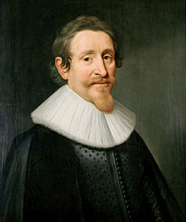
Its Roots
Western influenced
European, then US domination
Father of International Law
Age of Reason
Natural Law
¤
Hugo Grotius (1583-1645)

Slide 4
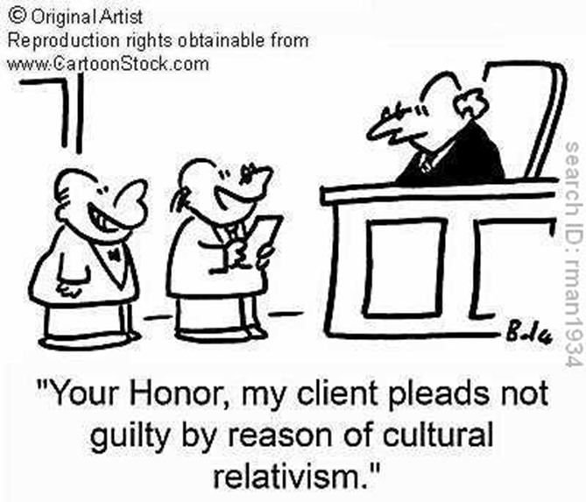
Issues
Early law → war
Contemporary law → transnational issues
More actors, contact
Need rules
Differences between cultures
Rules- Singapore & gum
Whaling
¤

Slide 5
Creating Int’l Law
UN ICJ -court UNODA -disarmament UNEP –env. Lots more for diff. issues
INTERPOL Coordinates policing
IMF Monetary regulation
WTO Trade regulation
States’ self-interests
Based on customs & agreements
Bilateral, multilateral pacts
Form IGOs
Help establish agreements
Monitor adherence
Compared to domestic law, IL is primitive
¤

Slide 6
Creating Int’l Law: Mercury Agreement
Why is the Minamata Convention important?
Mercury exposure = highly toxic
Bad for people
Minamata Disease
Harms environment
Soil, water, flora and fauna
Regulates supply, trade, use, emissions
Why did 140+ states agree?
In self-interest
Straightforward, uncontroversial objective
Fairly easy fix
¤

