Slide 1
International Law

Slide 2
Adherence

Slide 3
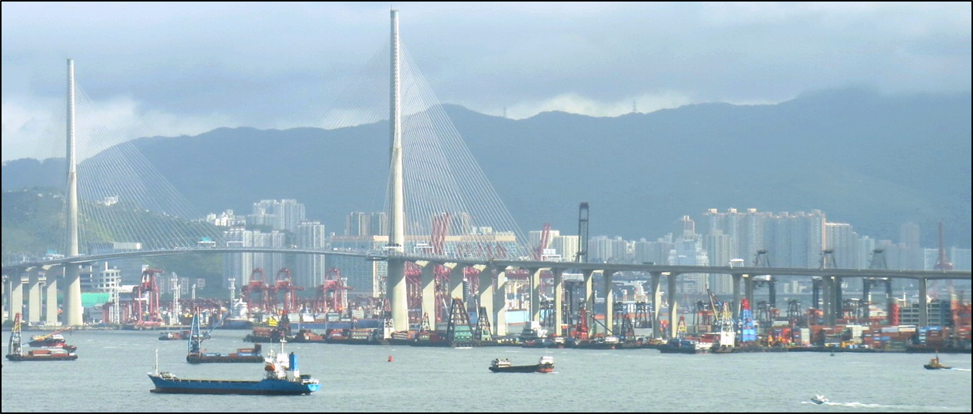
IL’s Primitive Nature
Based on customs, agreements
Coastal territory
3 miles
UN Law of the Sea Treaty to 12 miles w/ 200 EEZ
No overarching enforcement authority
Sovereignty
Requires cooperation
Self-interests
¤

Slide 4
Adherence to IL: Hito 1
What is at issue in A Line in the Sea?
Peru & Chile dispute
Peru turned to International Court of Justice (ICJ)
Wants more territory
1952 ‘treaty’ just fishing agreement
What was the ruling?
ICJ- Peru gets more territory
Hito 1 was customary line
Chile keeps inshore control
¤

Slide 5
Adherence to IL: Hito 1 (cont.)
Why will Peru and Chile likely comply?
Each got some territory
Got ICJ ruling- good to abide by it
Trade interests
Bolivia’s complaint
¤

Slide 6
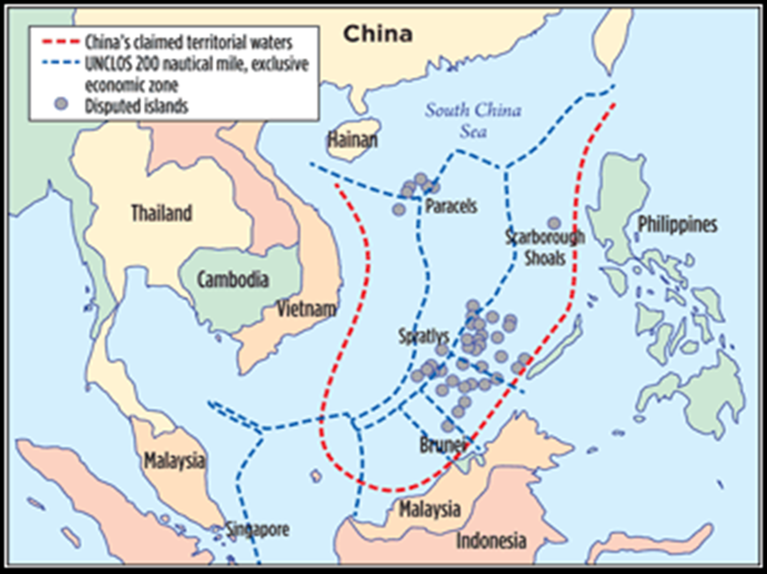
What is at issue in Force Majeure?

Slide 7
Adherence: SCS
What is at issue in Force Majeure?
China claims lots of the South China Sea
Exclusive Economic Zone (EEZ) claims
Philippines claim Spratly Islands, EEZ
IGOs to settle dispute: UN, ASEAN
Vietnam claims Paracel Islands, EEZ
Led to rioting
Why doesn’t China comply?
Claims are valid; UNCLOS is wrong
¤

Slide 8
Adherence to IL
So, is international law really law?
Compliance is voluntary
Russia annexed Crimea (2014)
Means of enforcement
Most states obey international laws- Why?
U.S. compiles w/ steel ruling; China w/ Jeeps
Reputation
Long-term benefits v. short term losses
Employ means to convince states to comply
Sets precedence for cooperation
¤

Slide 9
IL Recap
Roots of IL- Western
How IL is created
Why IL is primitive
SCS, Kashmir, Crimea as ex.
Why most states obey IL
Minamata, US & WTO, Peru/Chile as ex.
¤

